Slide 1

Small probabilities

Slide 2
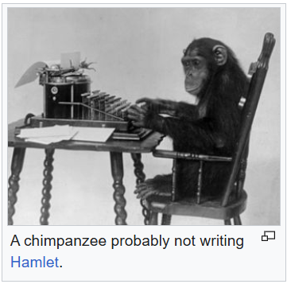
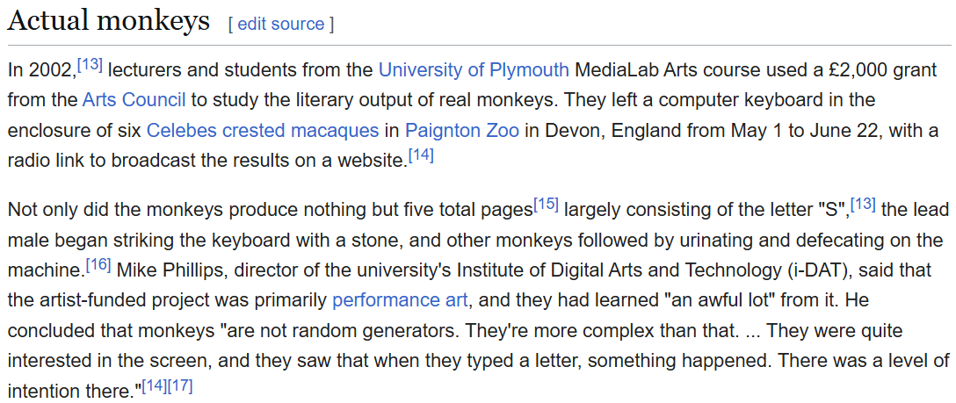
Infinite monkey theorem

Slide 3
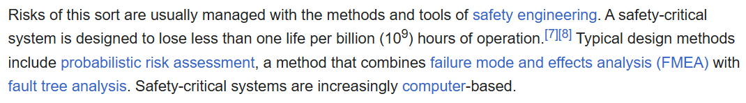
Can we just take the risks to 0?

Slide 4

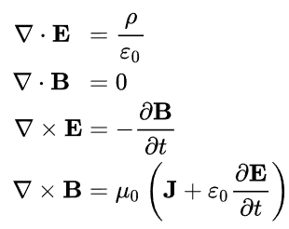
Laws of classical physics are continuous
All things are made of atoms — little particles that move around in perpetual motion, attracting each other when they are a little distance apart, but repelling upon being squeezed into one another

Slide 5
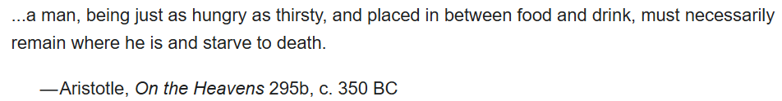

Slide 6
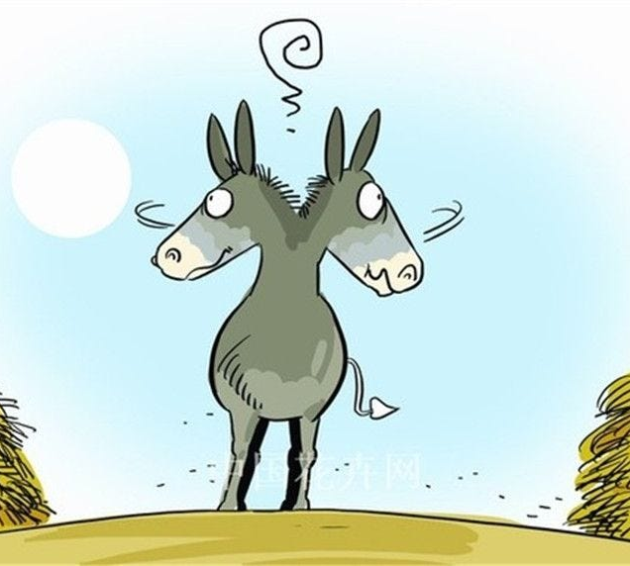
Buridan’s ass
The ass is a physical mechanism subject to the laws of physics. Any such mechanism is continuous, so A_t(x) is a continuous function of x. Since A_t(0) = 0 and A_t(1) = 1, by continuity there must be a finite range of values of x for which 0 < A_t(x) < 1. These values represent initial positions of the ass for which it does not reach either bale of hay within t seconds. Such a range of values of x exists for any time t, including times large enough to ensure that the ass has starved to death by then. Thus, there exists a finite range of starting positions for which the ass starves to death

Slide 7
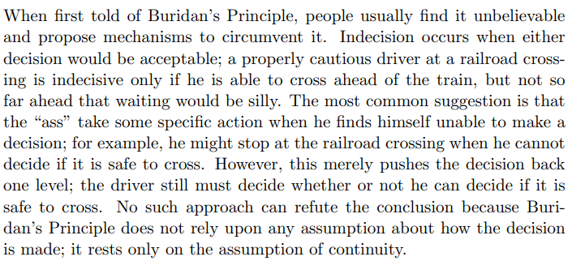
Propose your mechanism!

Slide 8
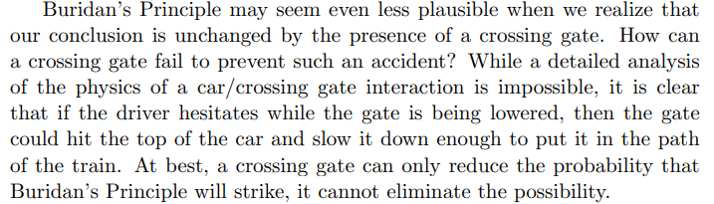
The gates don’t fully save the situation, but make it funnier

Slide 9
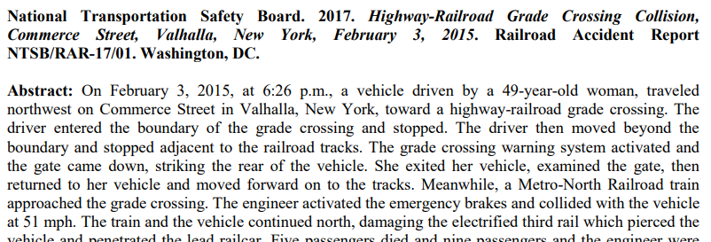
The gates don’t fully save the situation, but make it funnier

Slide 10

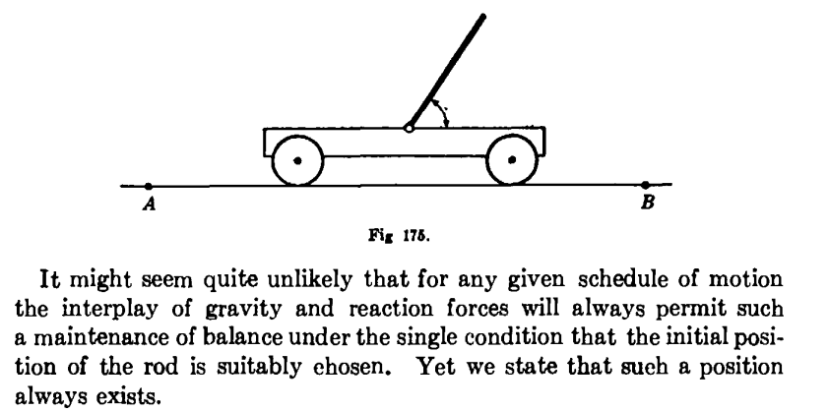

Slide 11

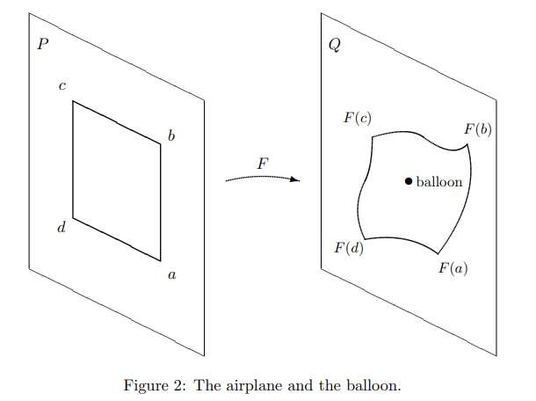

Slide 12

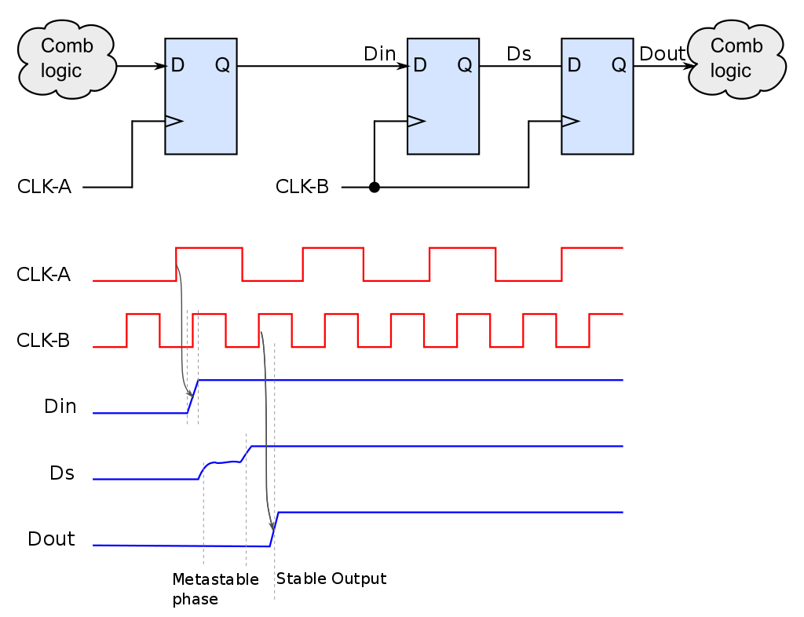
In electronics, metastability is the ability of a digital electronic system to persist for an unbounded time in an unstable equilibrium or metastable state.

Slide 13

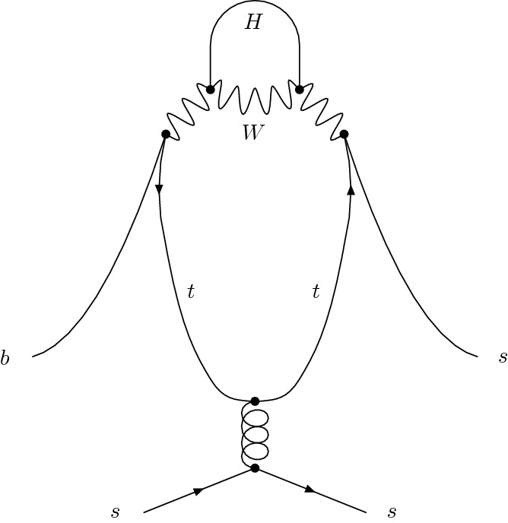

Slide 14
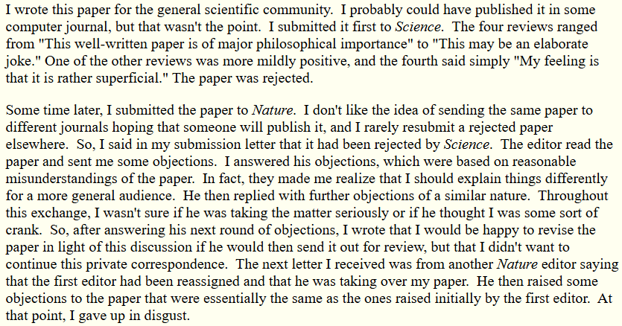
The paper took 30 years to publish

Slide 15
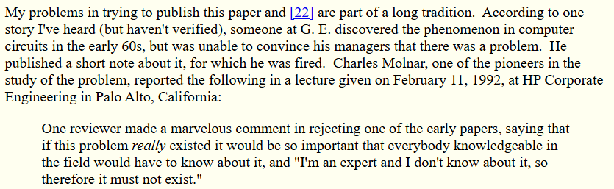
The paper took 30 years to publish

Slide 16
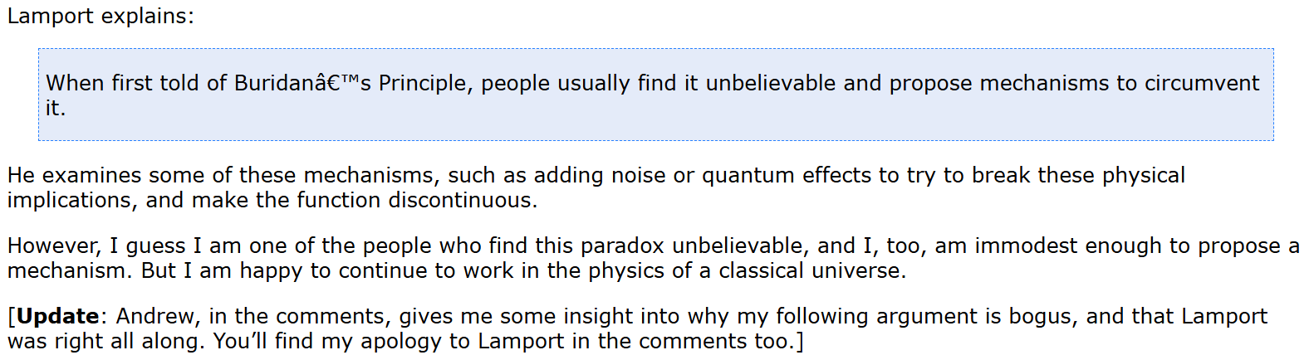
At the end, Leslie Lamport invented LaTeX for people to believe him

Slide 17
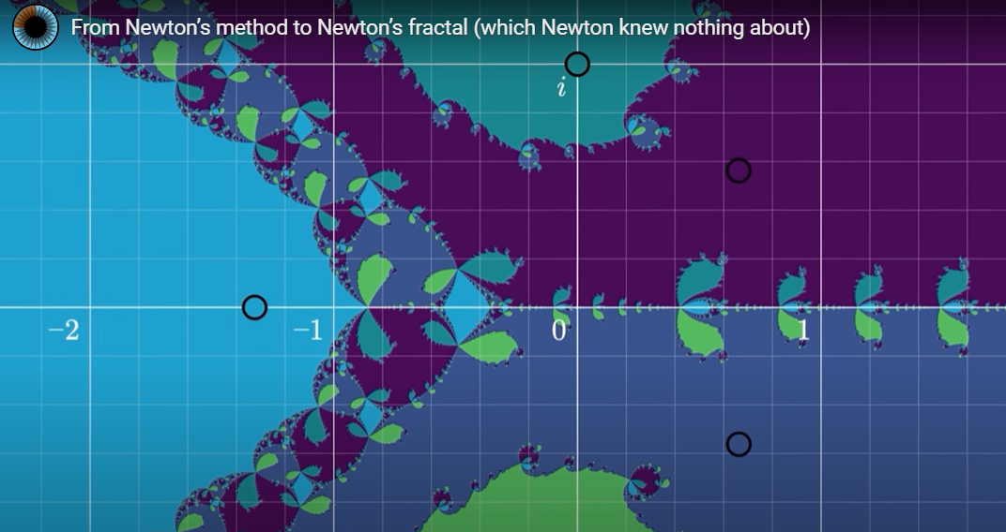
Newton’s fractal

Slide 18
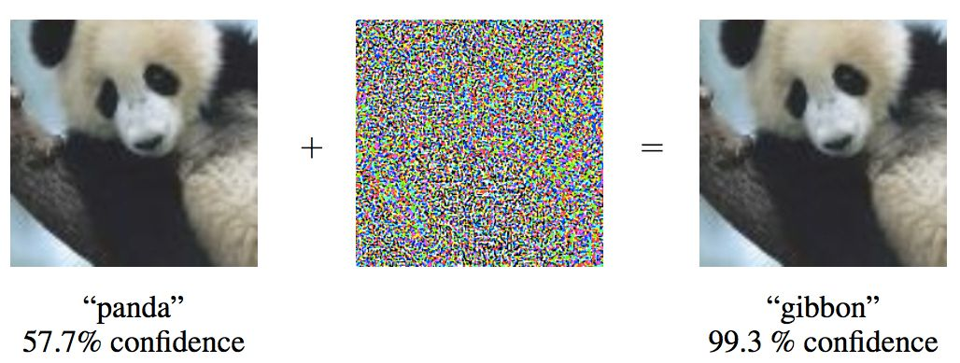
Noise

Slide 19
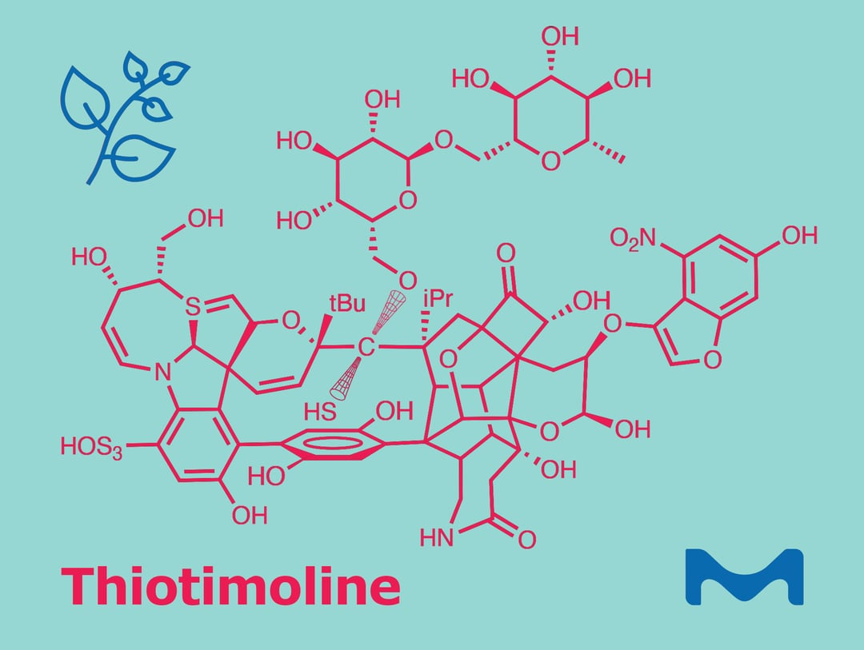
Azimov’s Thiotimoline
Other recommendations:
Strugatsky brothers “One Billion Years to the End of the World”
Plakhov “Stop Gregory”

Slide 20
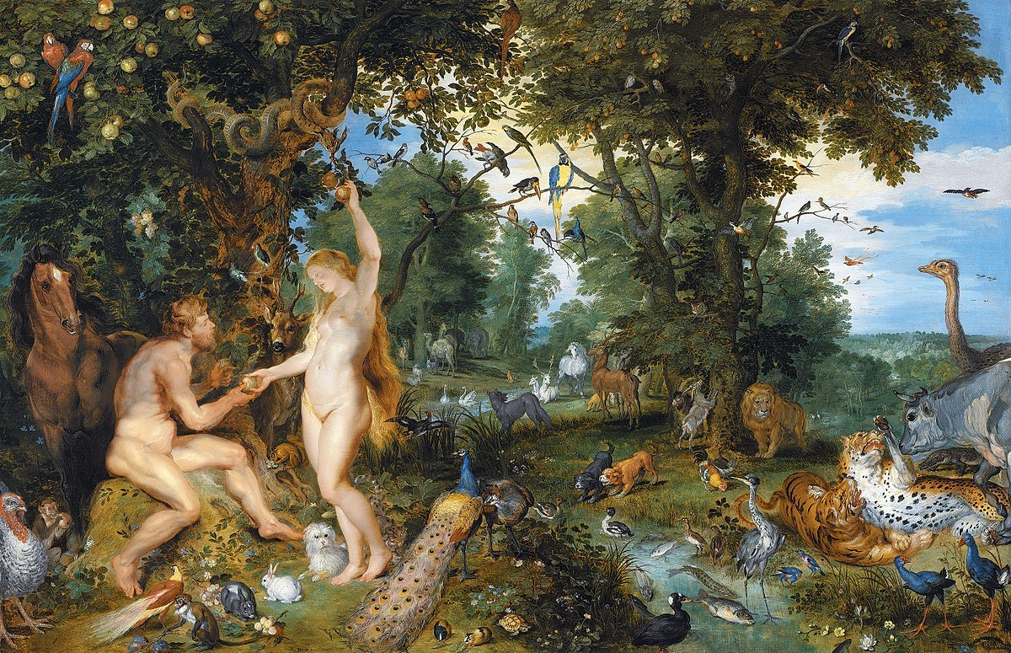
SSA and Adam and Eve

Slide 21
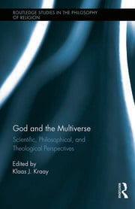
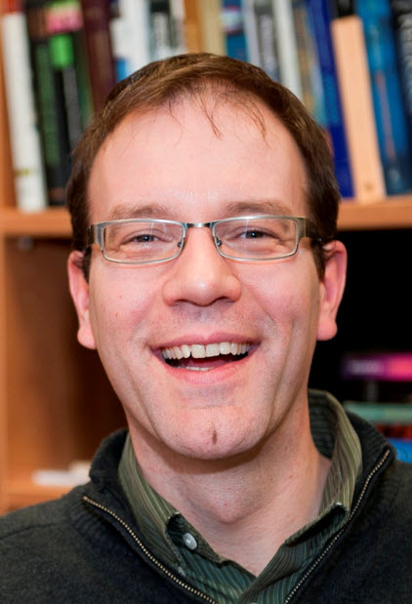
God and the multiverse (Klaas J. Kraay)

Slide 22
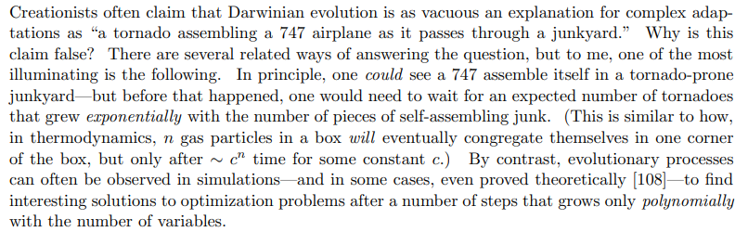
Why Philosophers Should Care About Computational Complexity by Scott Aaronson

Slide 23
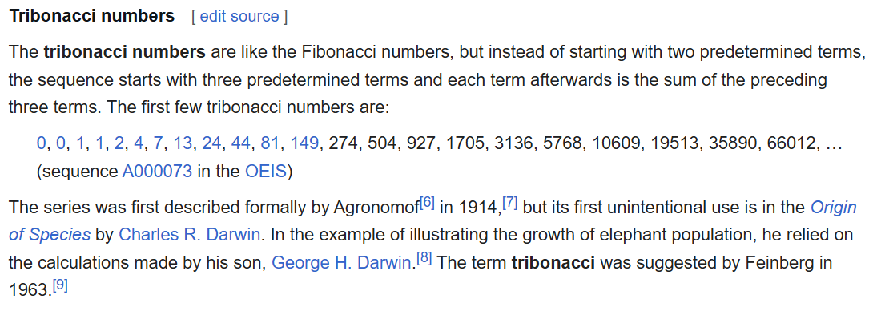
Darwin&Darwin

Slide 24
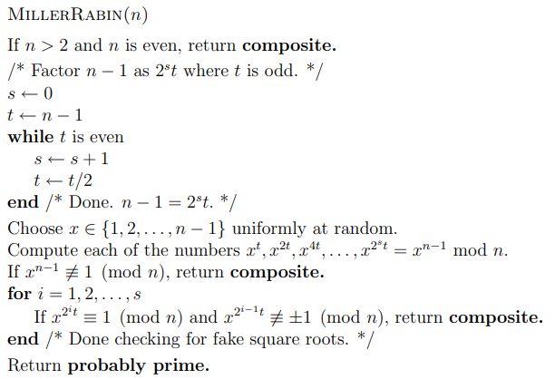
PRIMES before the AKS primality test
(BPP vs P)

Slide 25
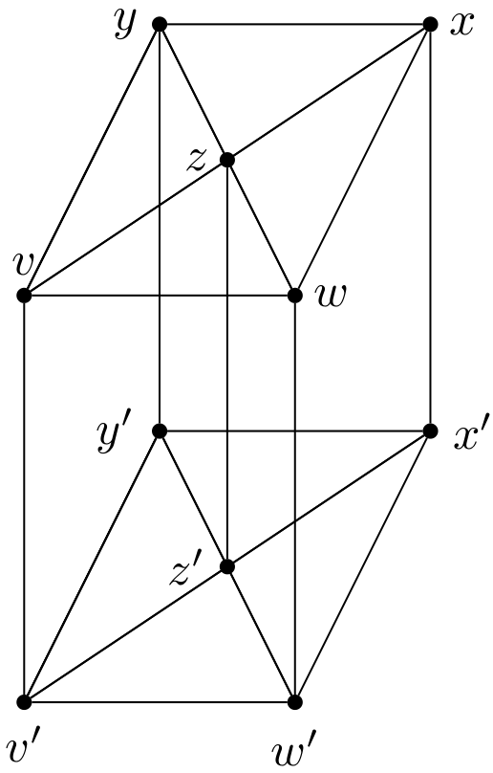
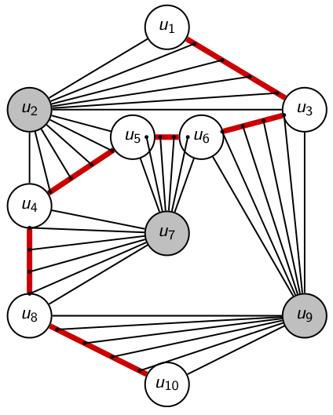
Bunkbed conjecture

Slide 26
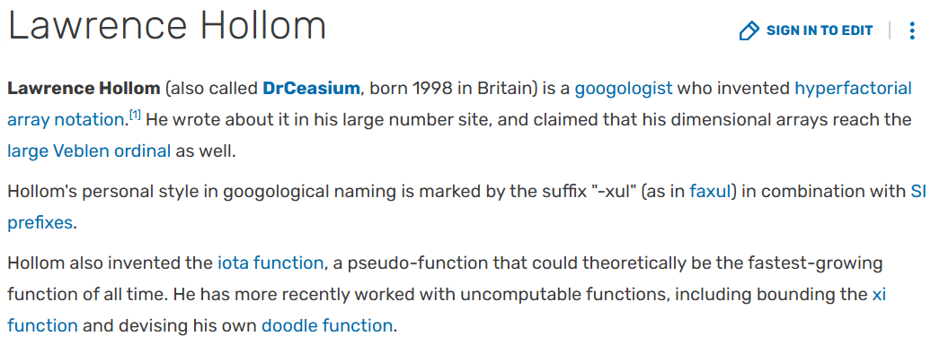
The iota function is sort of the ultimate "your number plus one" response to googology.

Slide 27
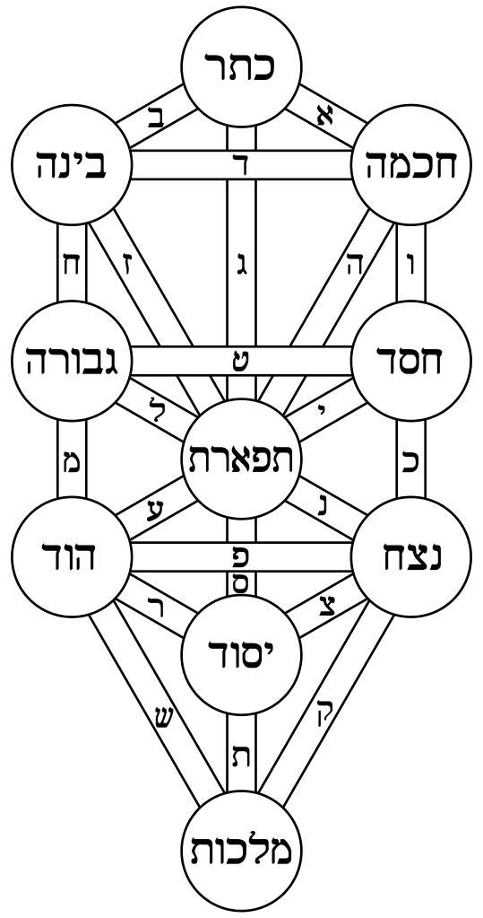
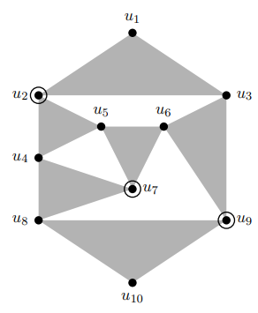
Tree of Life

Slide 28


Due to the multiple conditionings and the gadget structure, the difference of probabilities given by the counterexample in Theorem 1.2 is less than ${10}^{−4331}$, out of reach computationally.

Slide 29
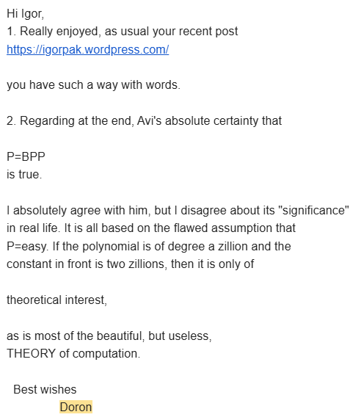
P.S. There is yet another layer to all of this. Back in 1999, I asked Avi Wigderson if P=BPP? He said “Yes“. Last week I asked him again. This is 25 years later, almost to the day. He said “Yes, I am absolutely sure of that.” It’s one of his favorite conjectures, of course. If he is right, every probabilistic counterexample can be turned into deterministic.

Slide 30
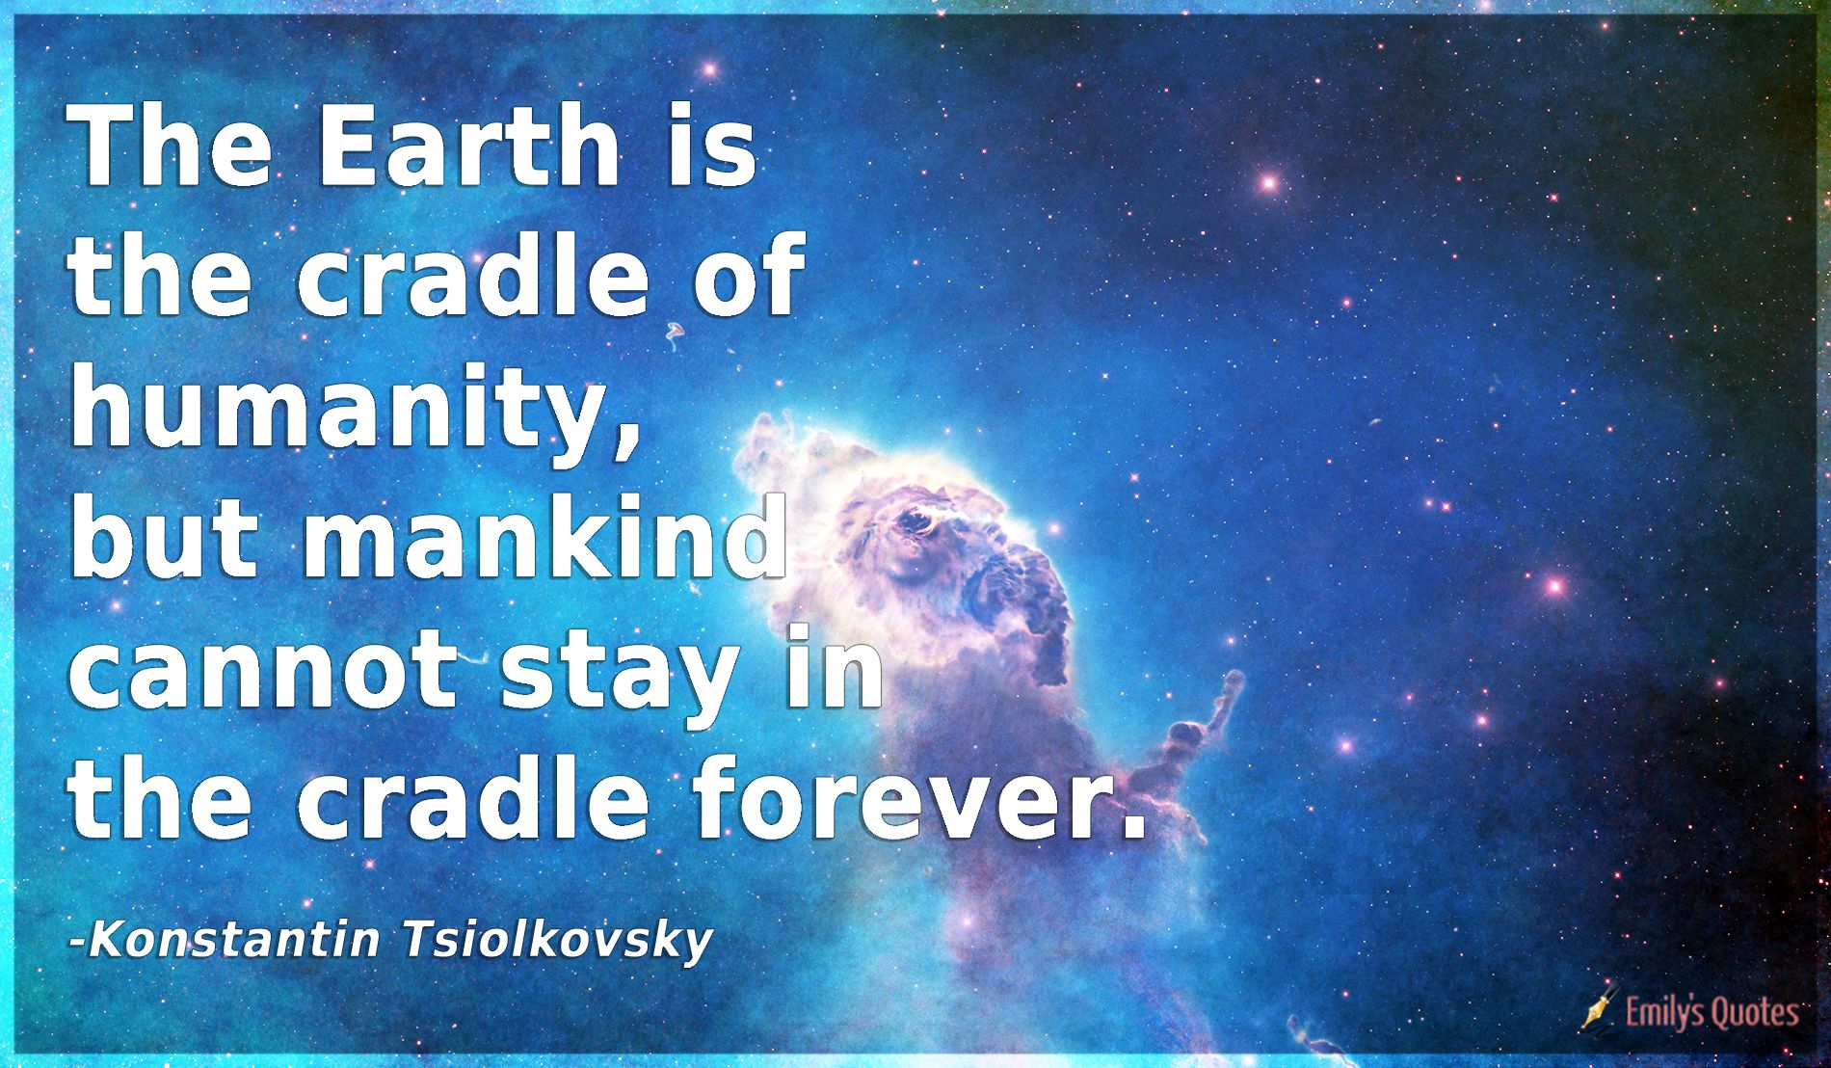

Slide 31
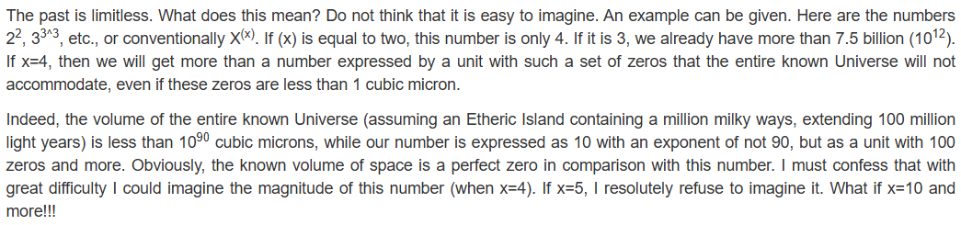
Tsiolkovsky’s cosmic philosophy

Slide 32
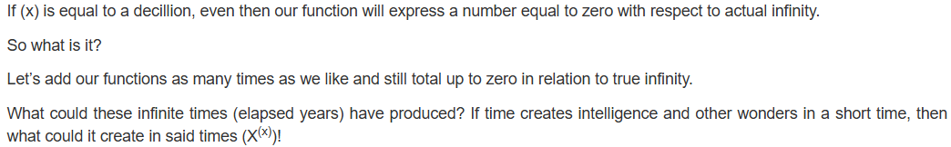
Tsiolkovsky’s cosmic philosophy

Slide 33
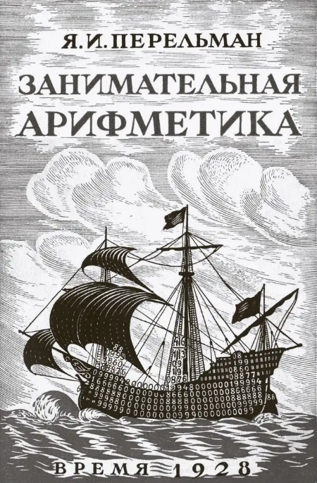
Yakov Perelman
I have quoted extensively from Jules Verne, H. G. Wells, Mark Twain and other writers, because, besides providing entertainment, the fantastic experiments these writers describe may well serve as instructive illustrations at physics classes.

Slide 34
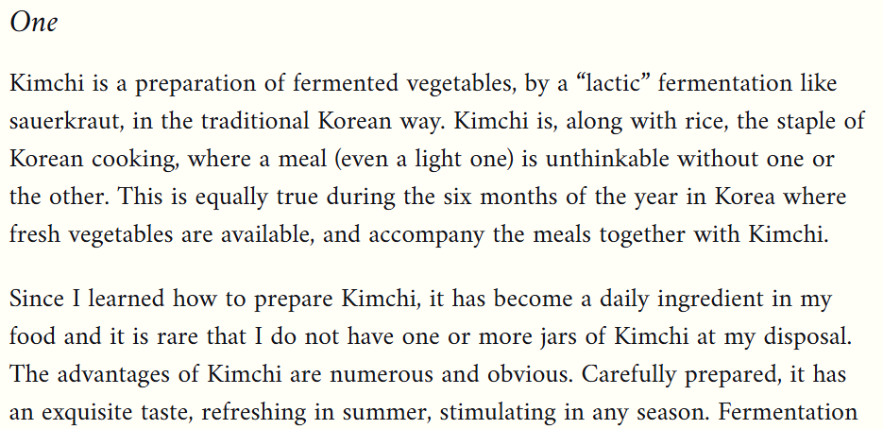
Guess the author

Slide 35
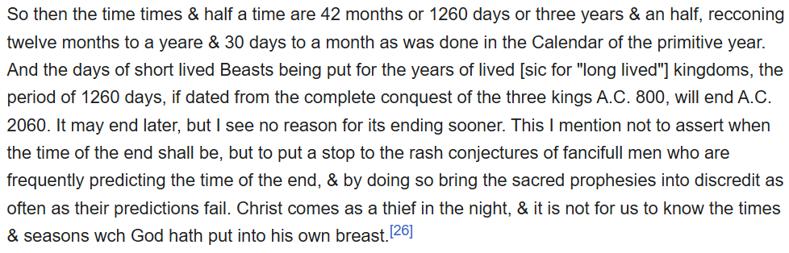
Guess the author

Slide 36
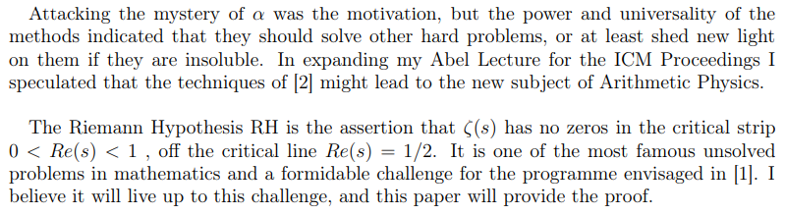
Guess the author

Slide 37

God bless your souls!

