Slide 1
The Puzzle to End All Puzzles

Slide 2
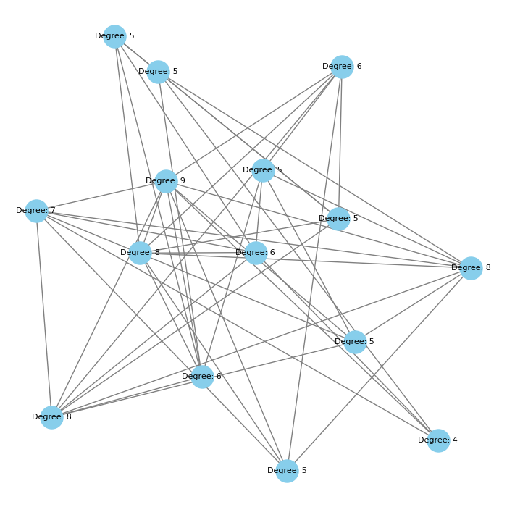
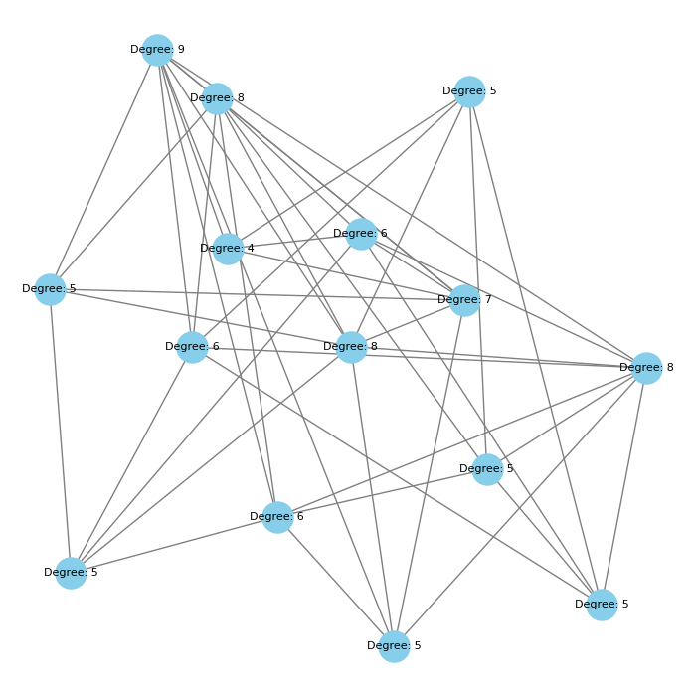
Zero-knowledge proof

Slide 3
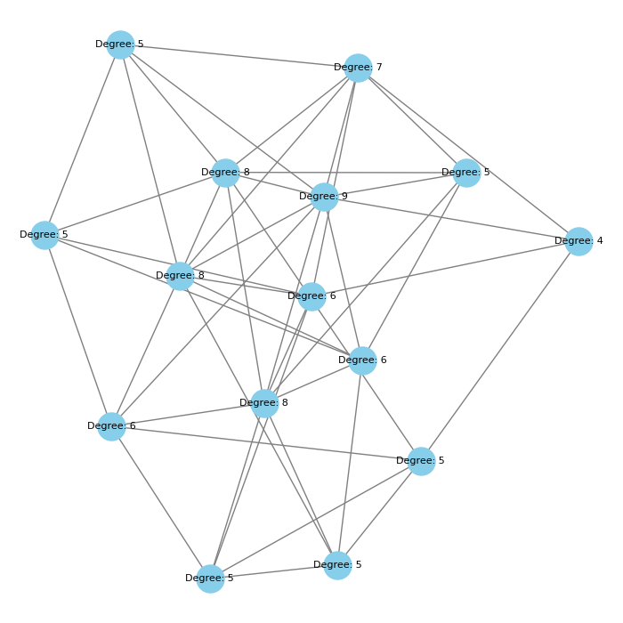

Slide 4
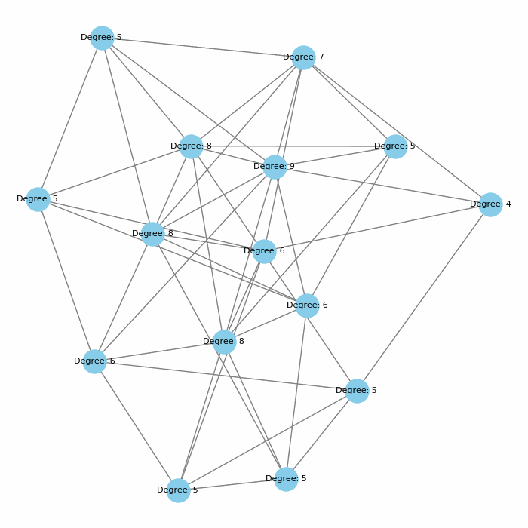

Slide 6
Proving 3-colorability
Without disclosing colors

Slide 7

Tale of the Tsar-mathematician
math.ucla.edu/~gladkovna/Quantum/FairyTale.txt

Slide 8
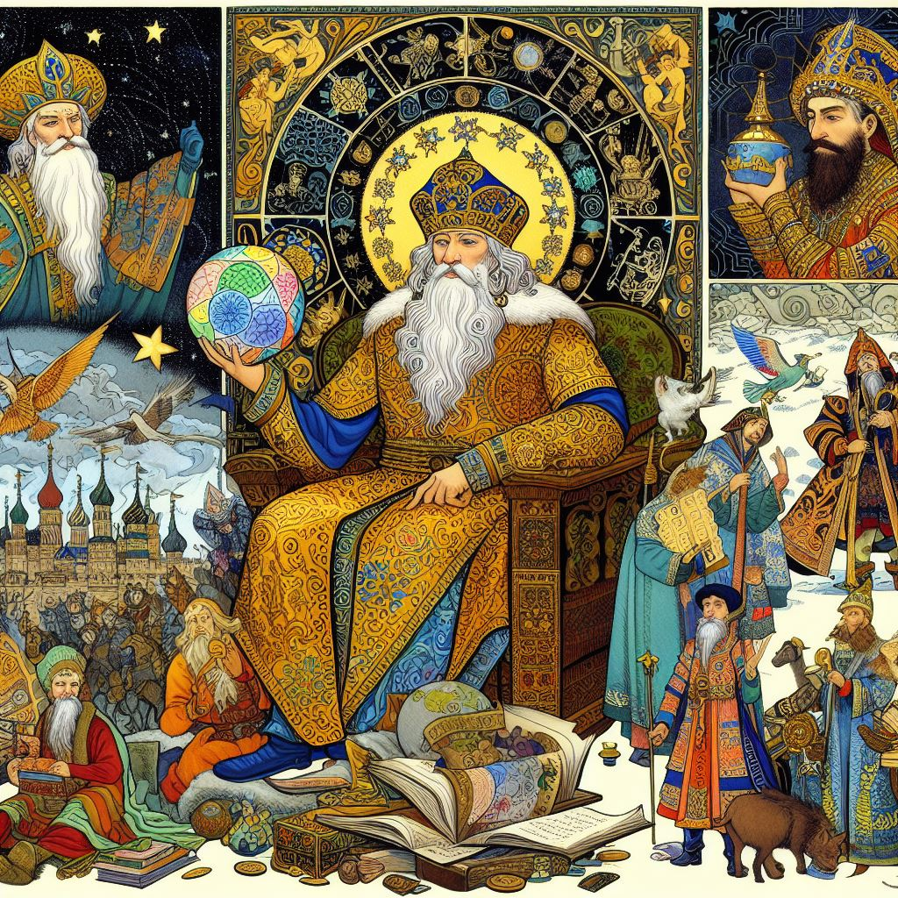

Slide 9
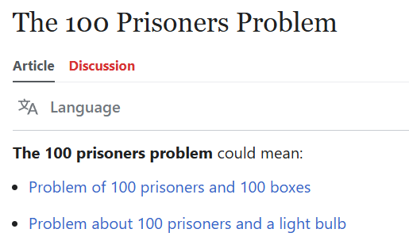

Slide 10
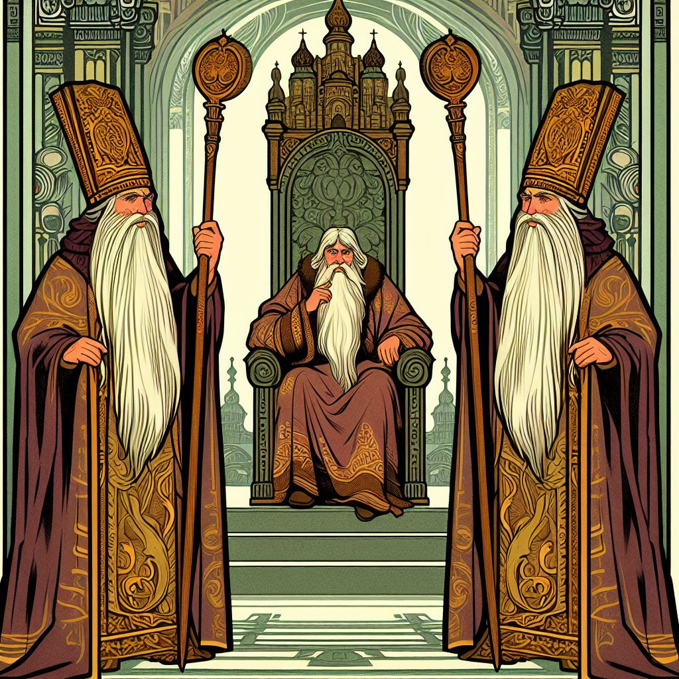

Slide 11
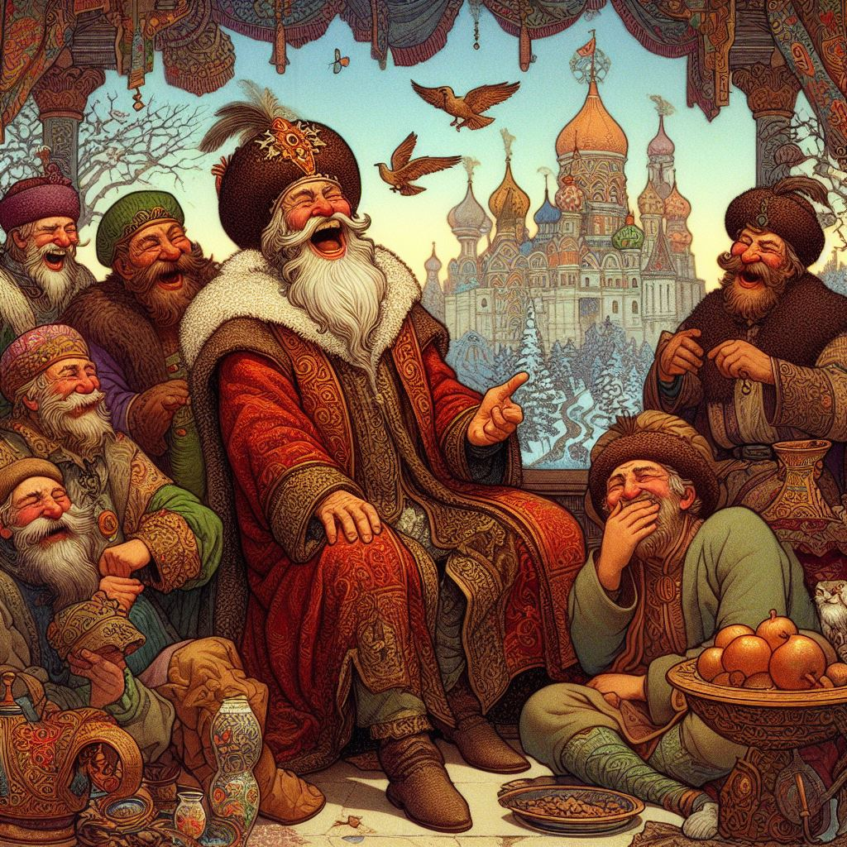

Slide 12
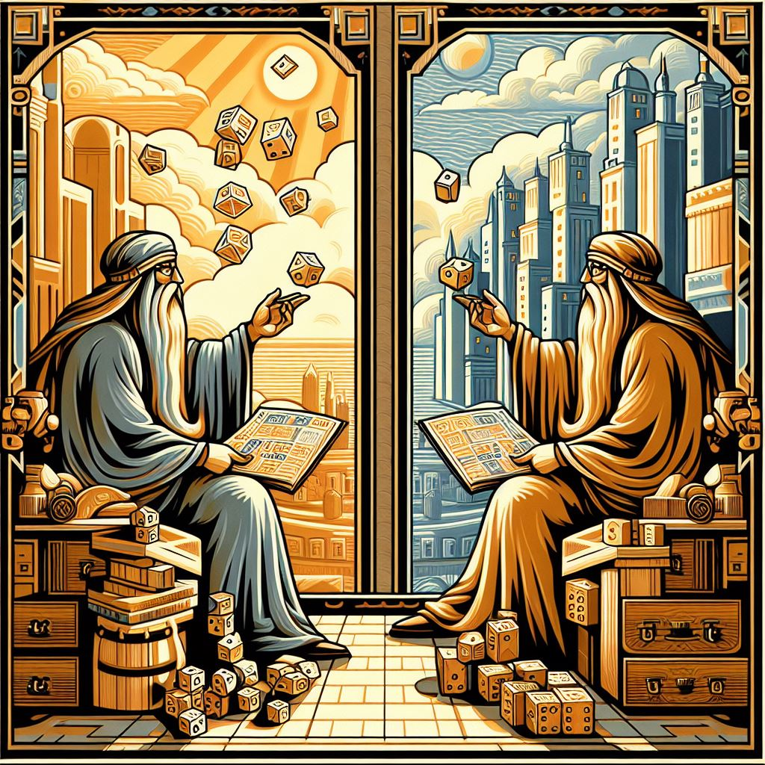

Slide 13
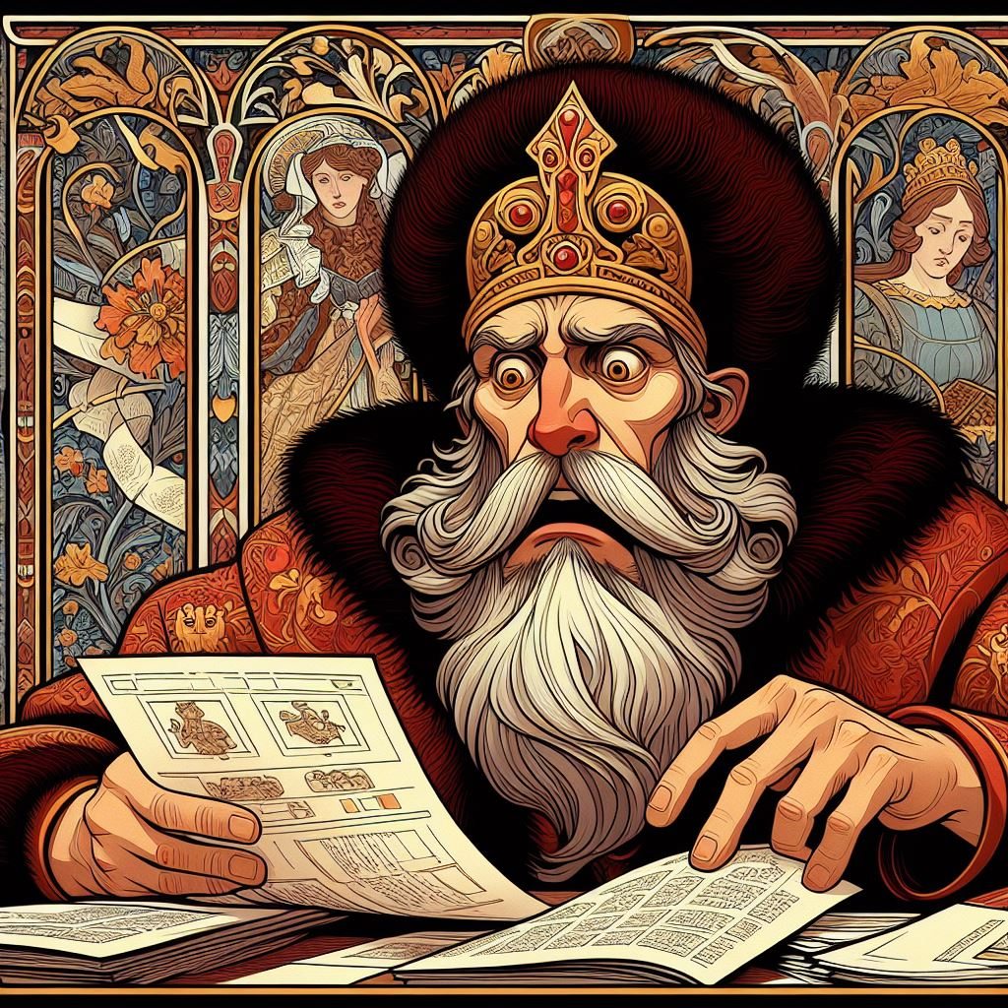

Slide 14
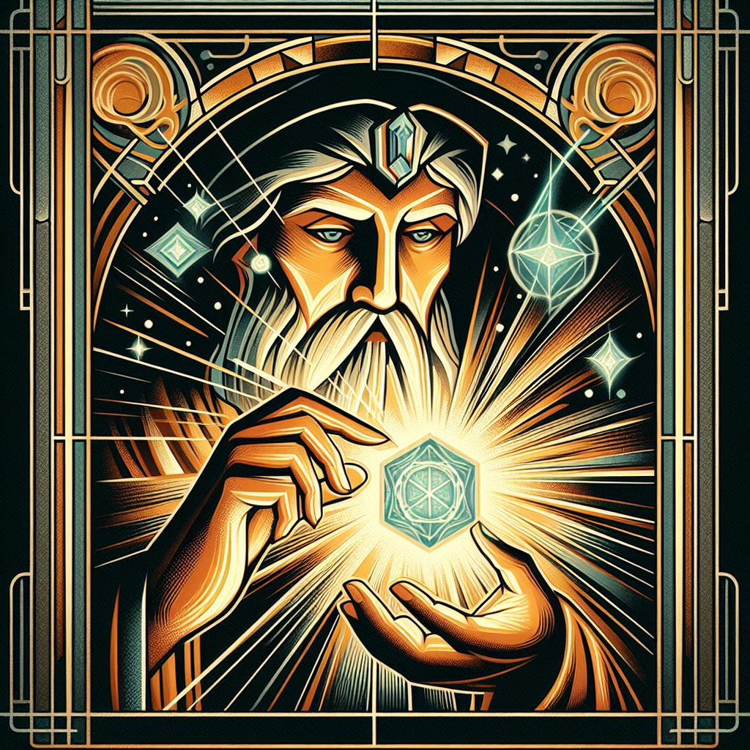

Slide 15
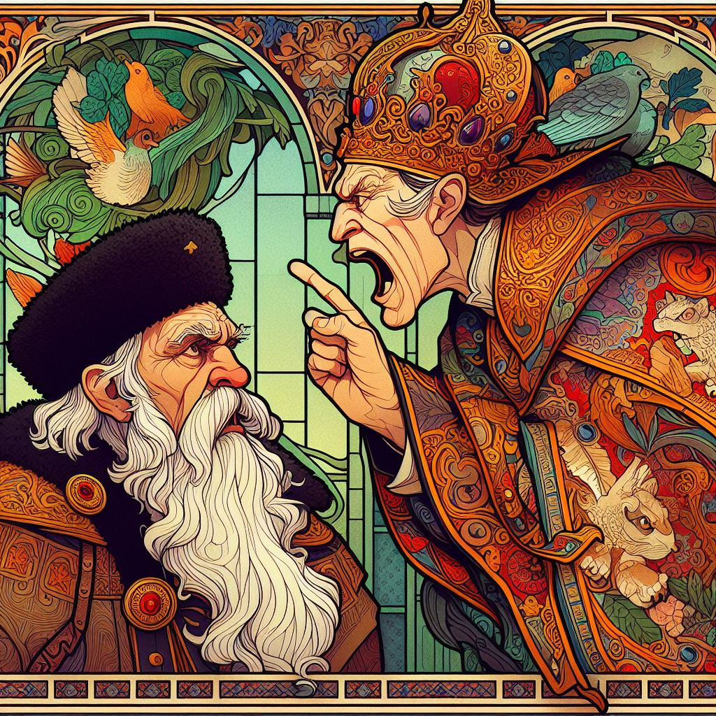

Slide 16
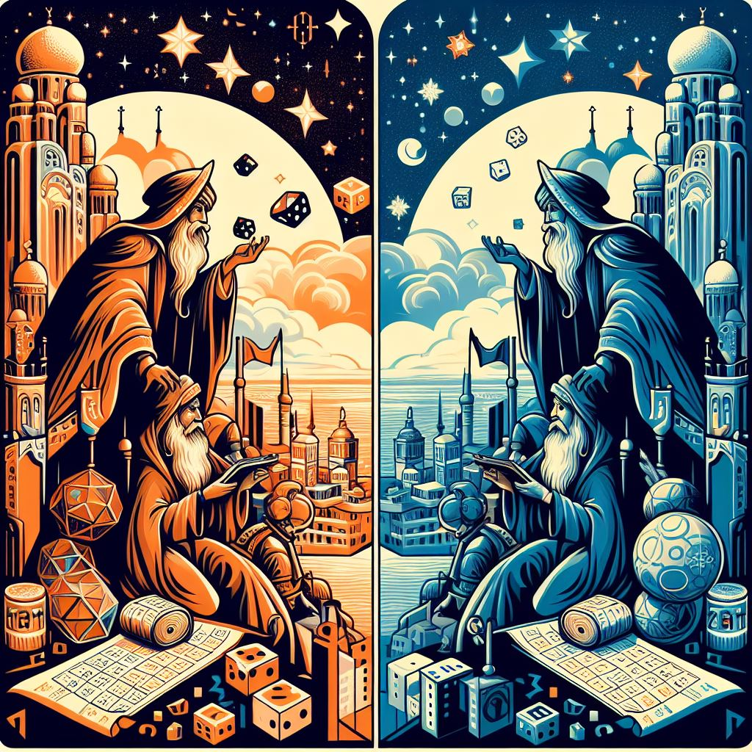

Slide 17
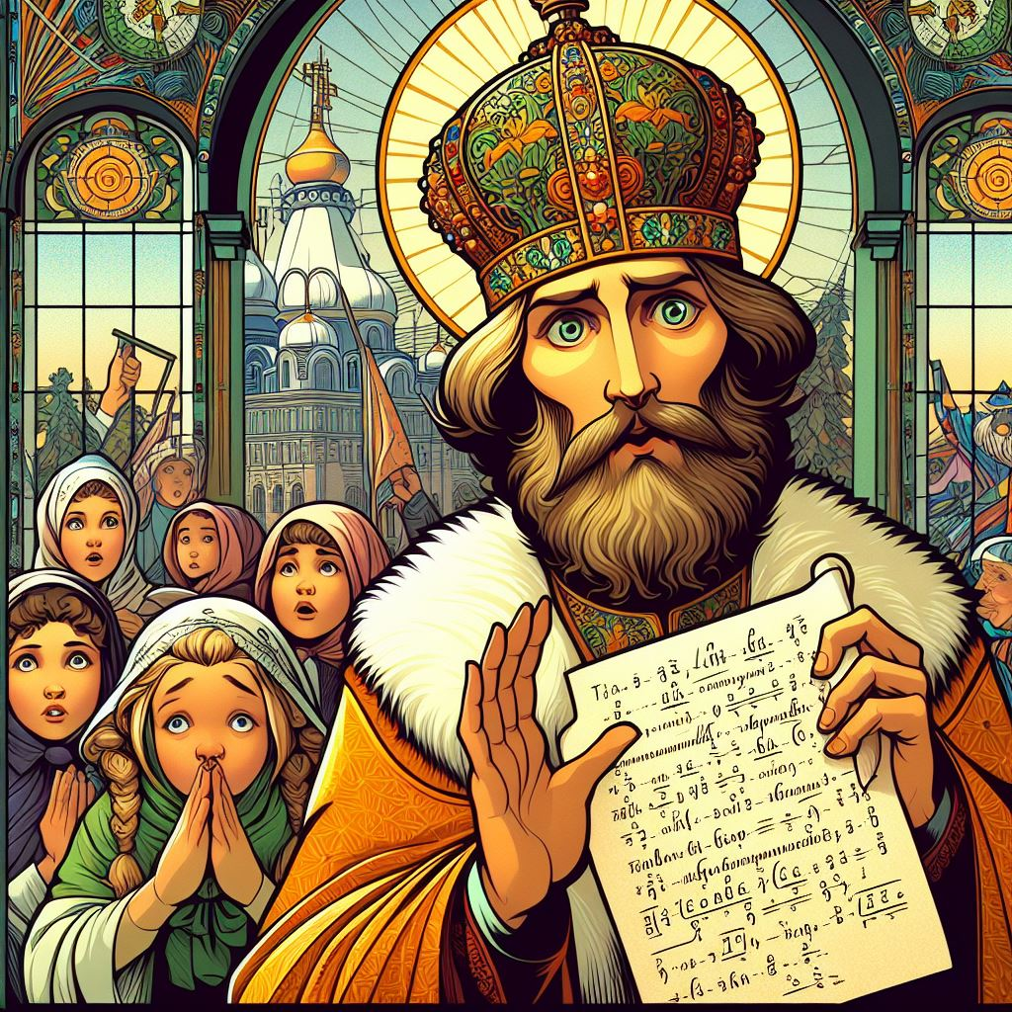

Slide 18
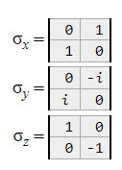
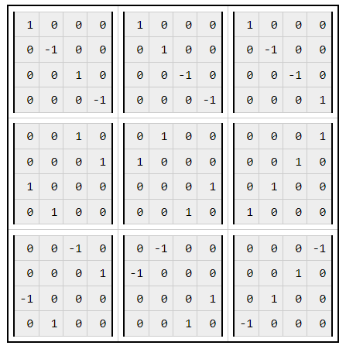
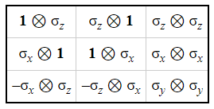
Mermin-Peres Magic Square

Slide 19
Time to code!
https://colab.research.google.com/drive/10rVfo5enLX2l-CryI5U-7aEeSO5vExwz?usp=sharing

