Slide 1
Ping Wang Images
Oilspill talk

Slide 2
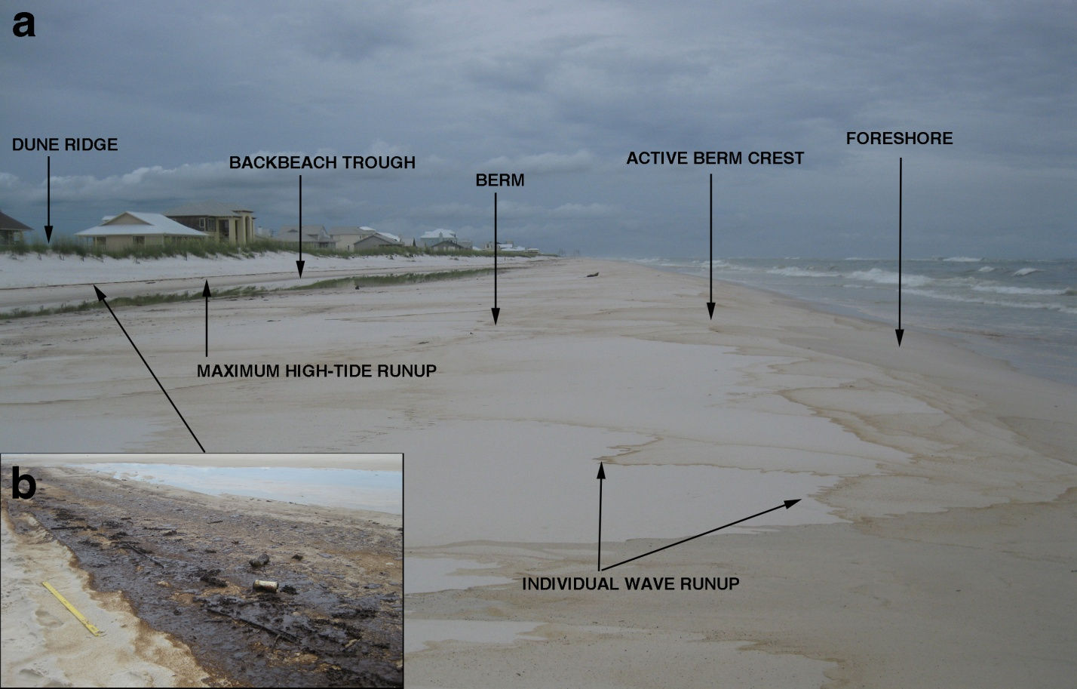
Morphological environments on contaminated beach, July 1
Courtesy of
Ping Wang, USF

Slide 3
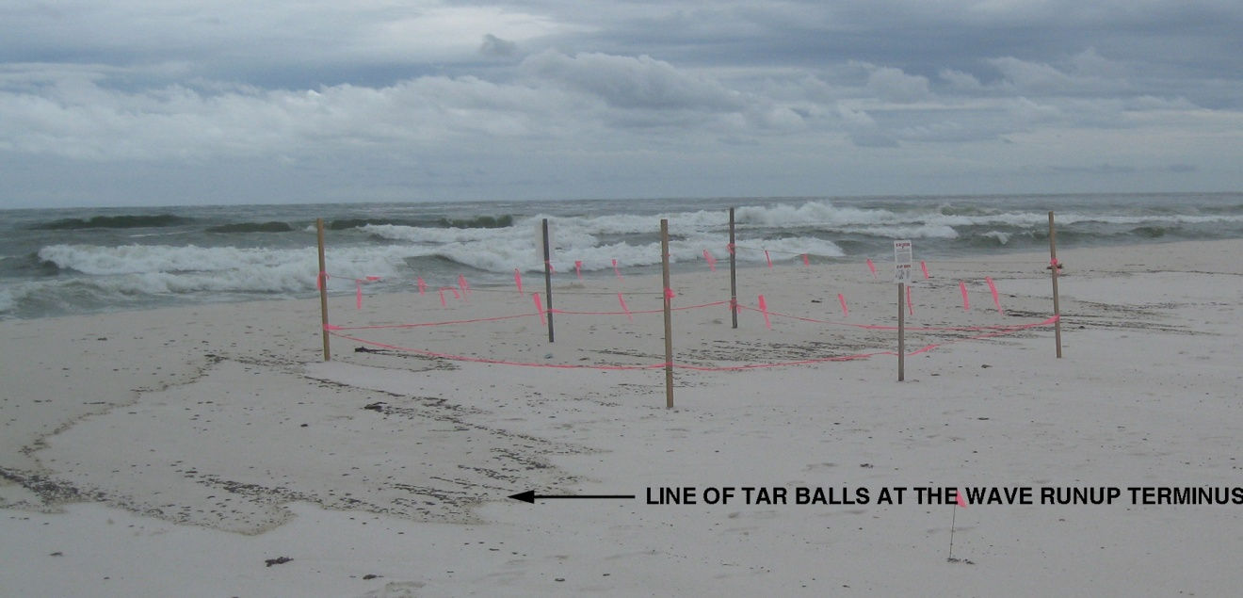
After Hurricane Alex
Deposition of tar balls and oil stain in association with individual wave runup. The wave runup due to high waves associated with the hurricane transported the oil contamination over a distance of up to 30 m landward of the active berm crest, covering an active turtle nest. Photo taken July 1, 2010.
Courtesy of Ping Wang USF

Slide 4
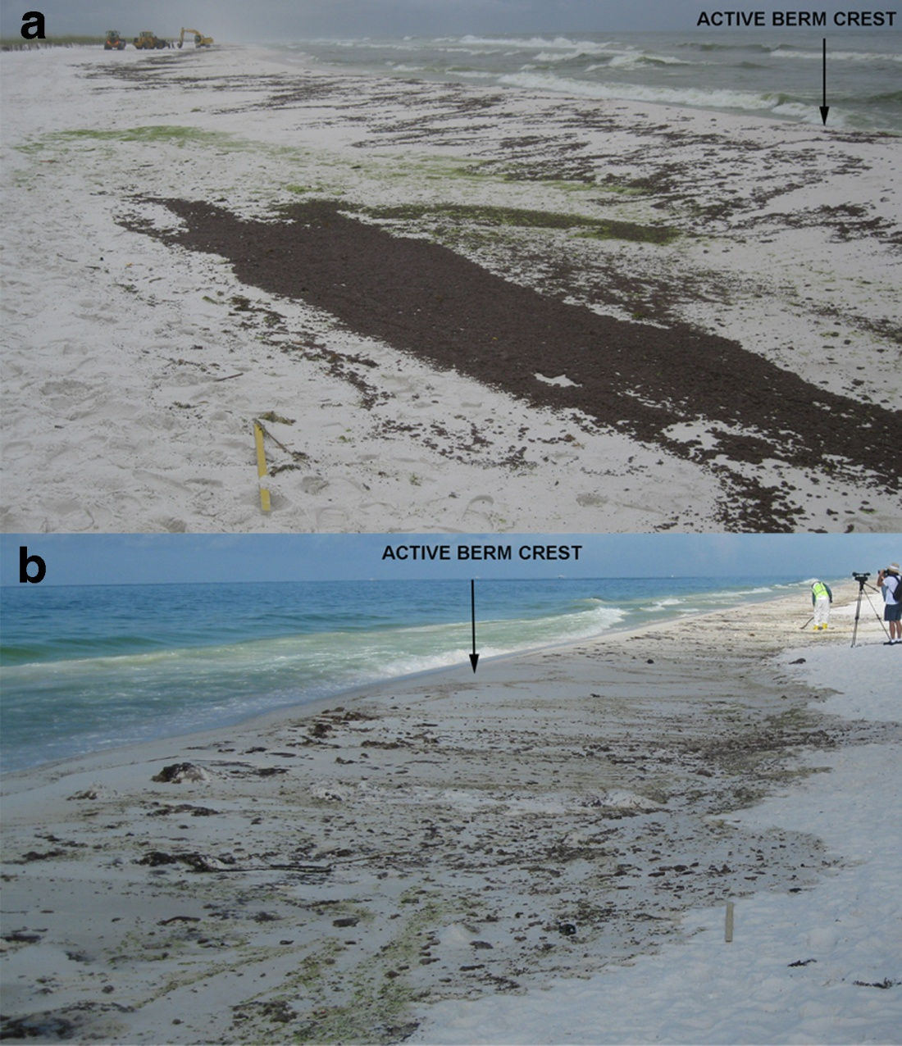
Types and cross-shore distribution of oil contamination
(a) Concentrated tar balls and tar patties at the maximum high-tide runup and patchy tar balls distribution between the active berm crest and the upper limit of wave runup. (b) Oil stains and tar balls distribute on the surface between the active berm
crest and the maximum high-tide runup. Note: The zone of oil contamination of (a) is much wider than (b), due to variations in wave energy. Courtesy of Ping Wang, USF.
June 30, 2010 during hurricane.
June 24 pre-hurricane

Slide 5
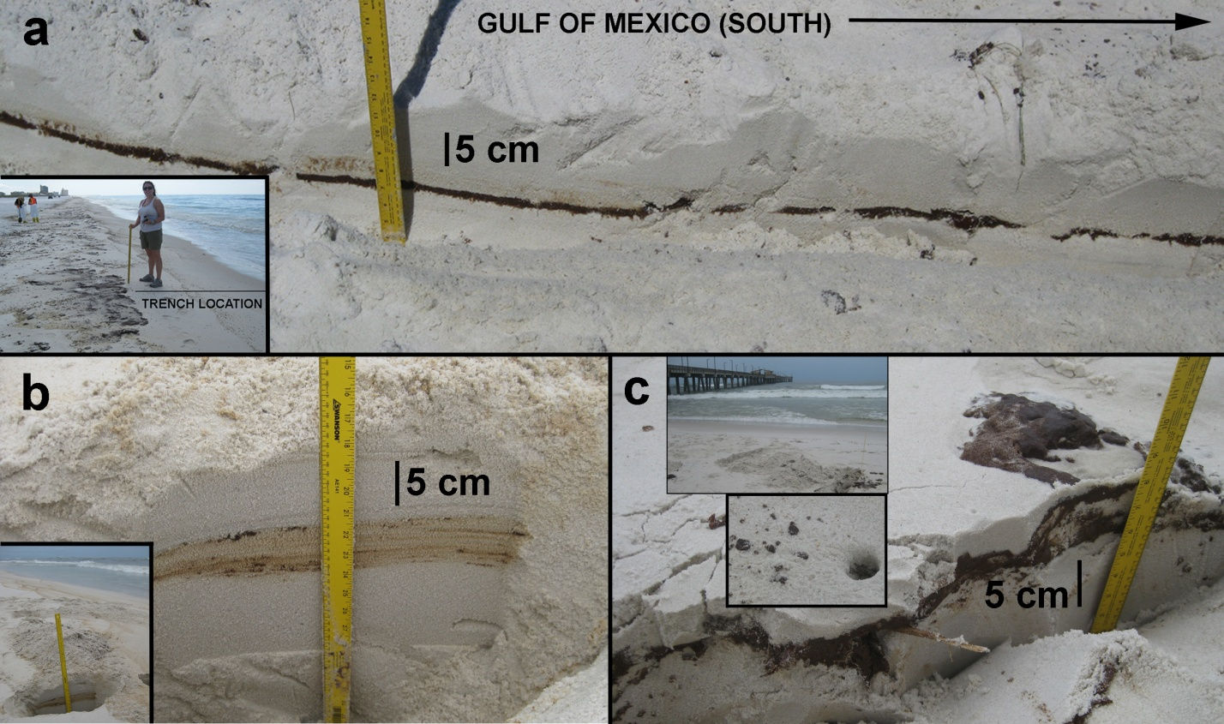
Buried Oil
Notes:
Various forms of buried oil. (a) Shore perpendicular trench in the foreshore sub-environment (inset) illustrating a continuous layer of buried seaward-dipping sheet of oil. Photo taken June
24, 2010. (b) Shore perpendicular trench excavated slightly landward of the active berm crest (inset) illustrating laminations of stained oil and tar balls buried beneath clean sand. Photo taken
July 1, 2010. (c) Shore perpendicular trench excavated slightly landward of the active berm crest (upper inset) illustrating a partially buried thick tar cake. Lower inset: Burrow of beach fauna
through a thin layer of oil contamination in a nearby area. Photos taken July 1, 2010.

