Slide 1
Bi-disperse Particle-laden Flows in the Stokes Regime
UCLA Summer REU 2012
Kali Allison
Thomas Crawford
Saro Meguerdijian
Wylie Rosenthal
Gilberto Urdaneta
Supervisors:
Dr. Sungyon Lee
Dr. Aliki Mavromoustaki
Principal Investigator:
Dr. Andrea L. Bertozzi

Slide 2
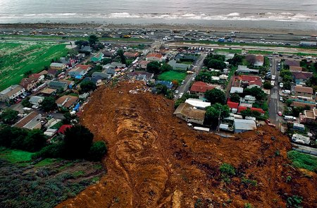
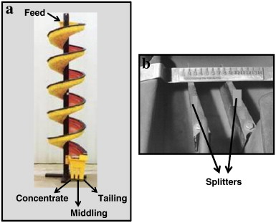
Motivation
Flow of particle-laden fluid can be observed in nature and is applicable to many problems in science and engineering.

Slide 3
Presentation Outline
Experimentation
  The Acquisition Process
  Qualitative Data And Trends
  Quantitative tracking of flow
Modeling
  Two-phase model and the lubrication equations
  Mono-disperse results
  Bi-disperse model and results

Slide 4
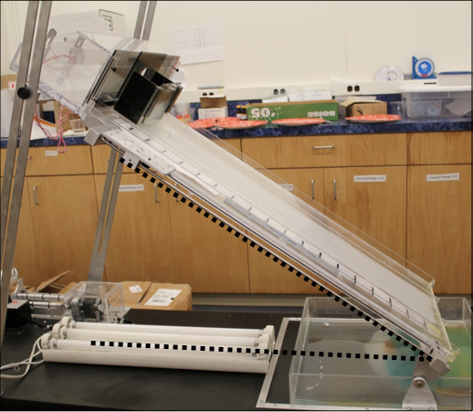
Experimental Setup
Particle Size and Density
  Ceramic 0.3±.1 mm and 3.8 g/mL
  Glass 0.39 ±.14 mm and 2.475 g/mL
Angle of Inclination (10°-70°)
DSLR Camera
  60 Images/Min
  Video of Each Run
Parameters
  Oil Viscosity (1000 cSt)
  Oil Density (0.97 g/mL)
  Particle Concentration (0.20-0.50)

Slide 5
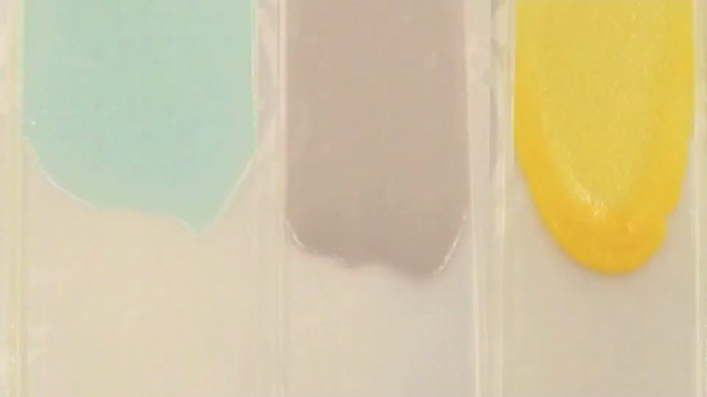
Mono-disperse Flow
Angle: 35˚
Φ=0.25
Φ=0.35
Φ=0.50

Slide 6
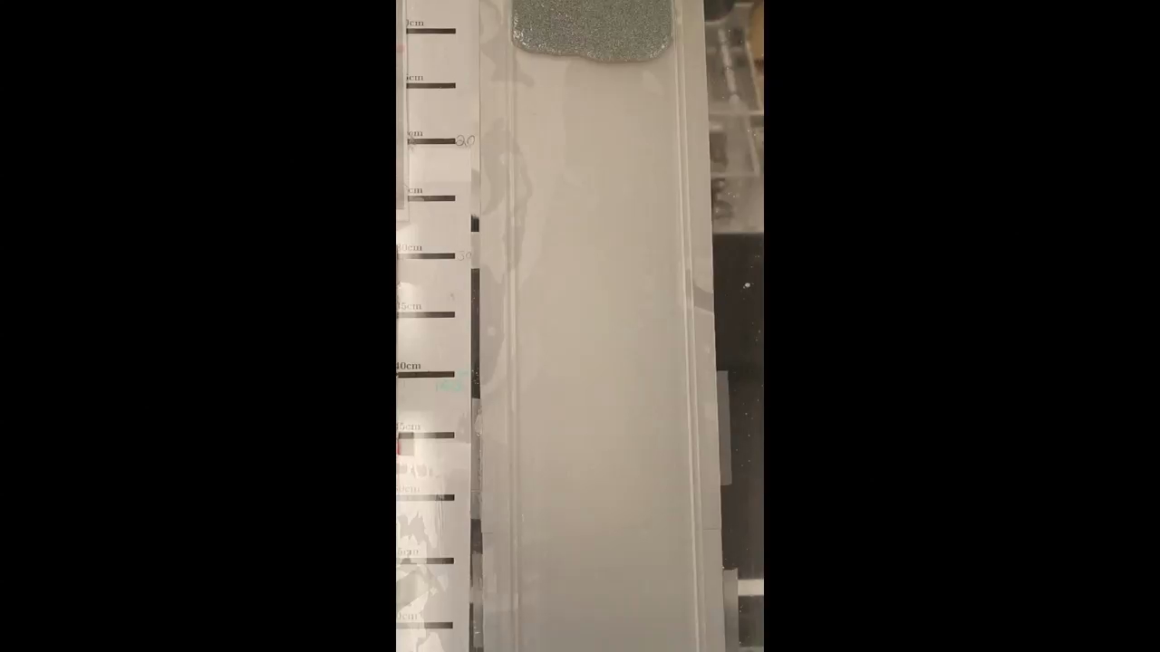
Bi-disperse Flow

Slide 7
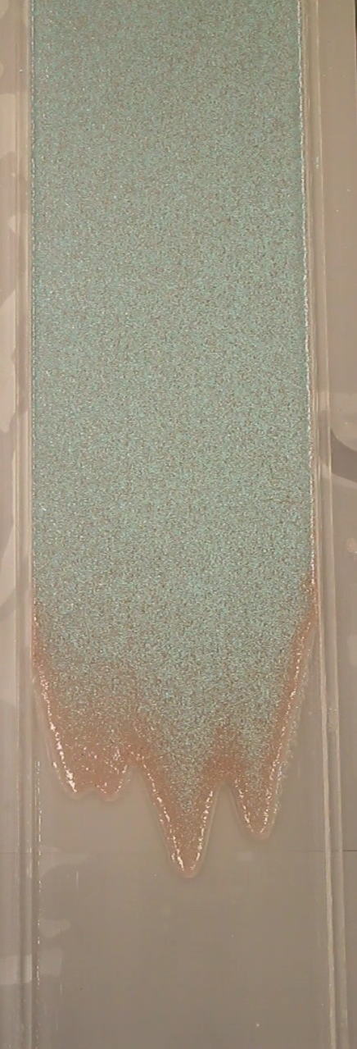
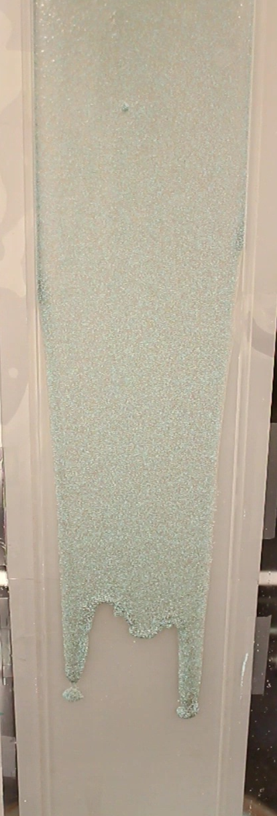
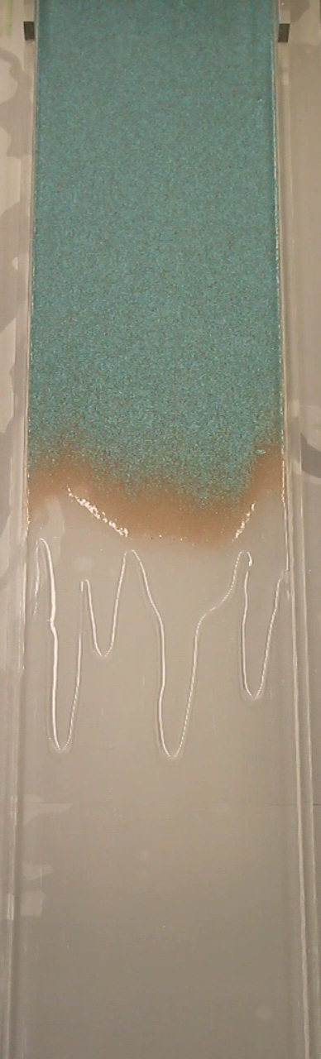
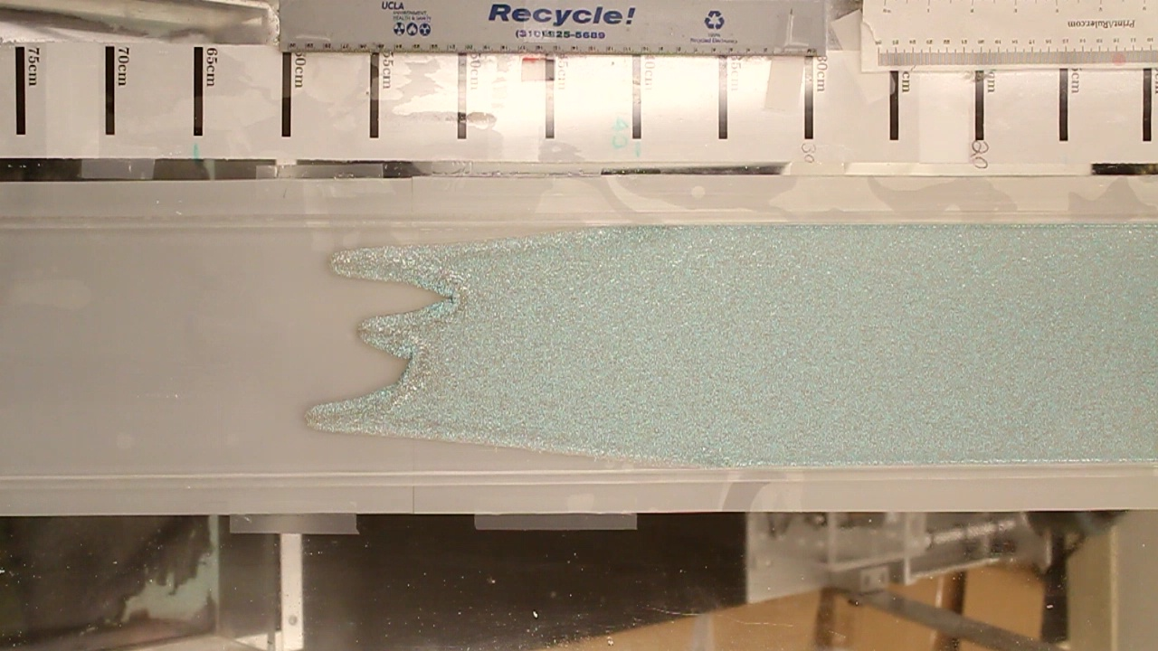
Regimes
Constant Bead Ratio 50:50 (GSB5:Ceramic)
Total Volume Fraction: 0.4
20˚
30˚
40˚
60˚
Settled
Well-mixed
Ridged
Break-off

Slide 8
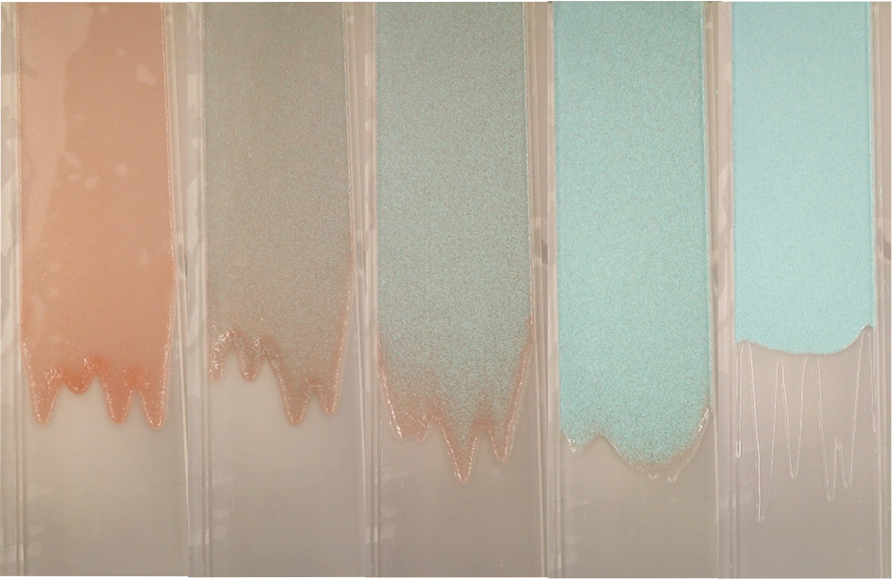
Regimes
Constant Angle: 30˚
Total Bead Volume Fraction: 0.4
Ridged
Ridged
Well-mixed
Settled
Settled
All glass beads
75:25
50:50
25:75
All ceramic beads
Notes:
Hi everyone my name’s Gilberto and just a quick reminder
And I will be presenting some of our experimental results

Slide 10
Notes:
Transitional stage faster

Slide 11
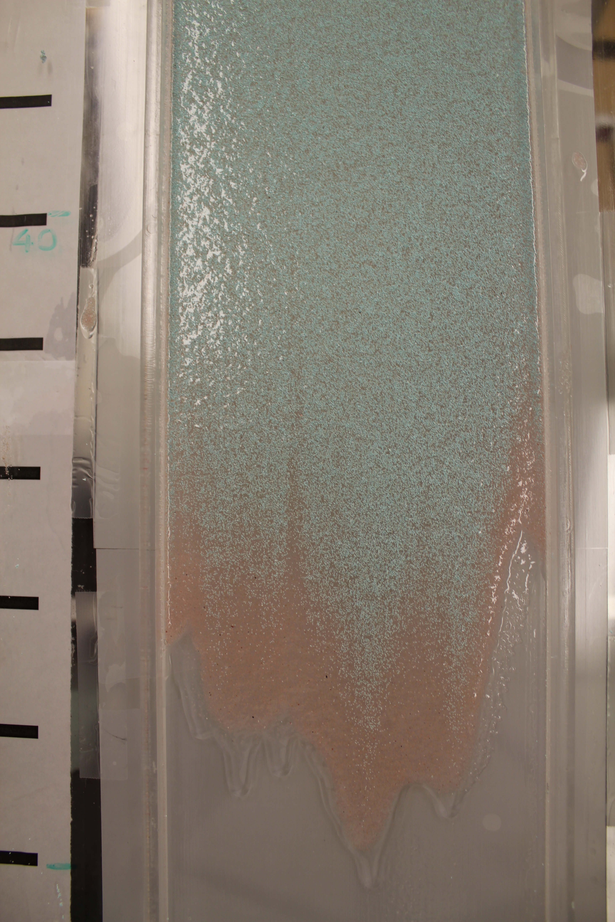
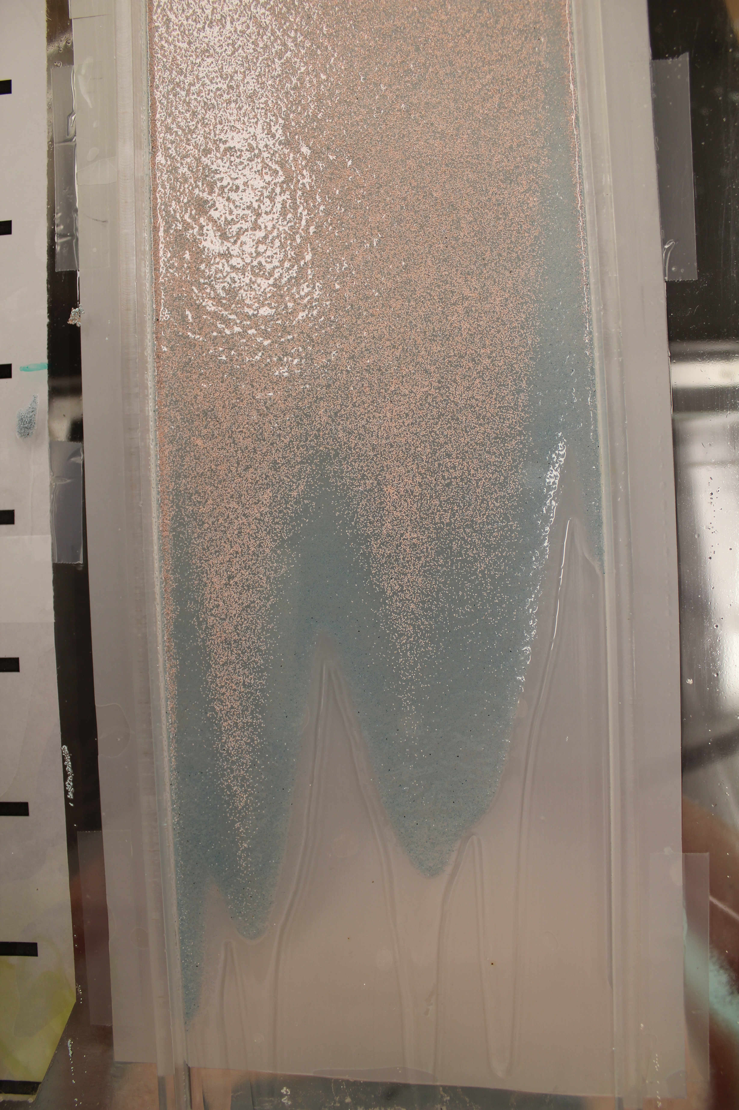
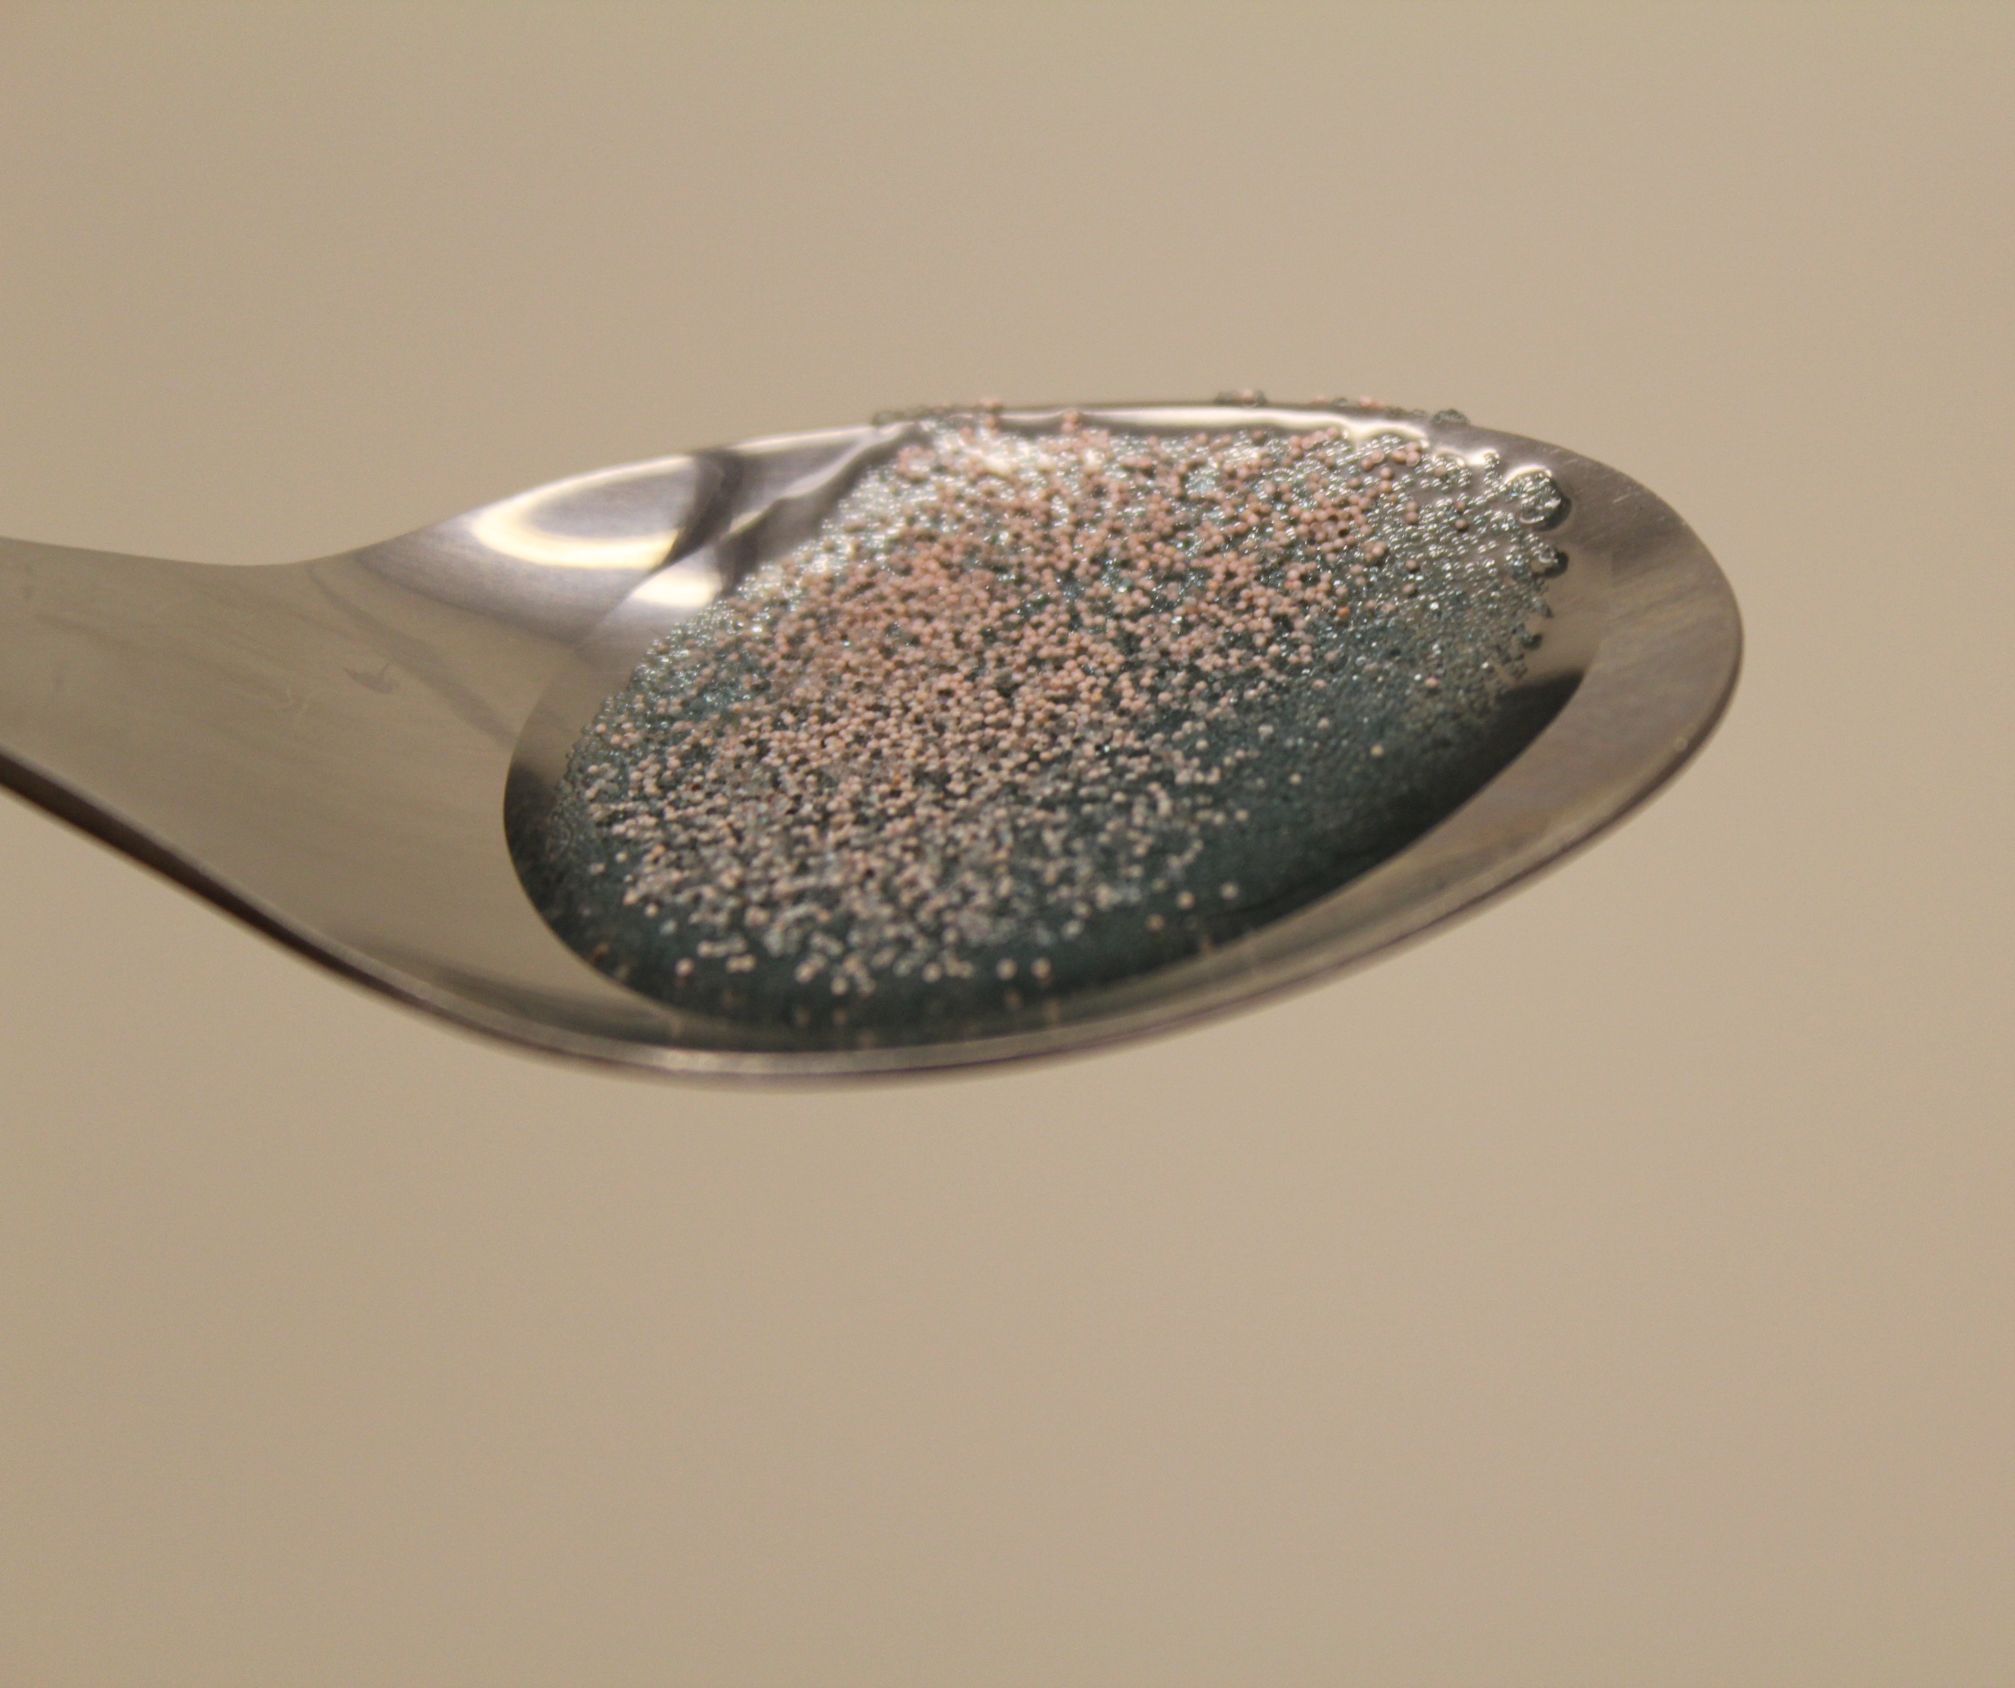
Result: Ceramic beads migrate on top
Notes:
We even inverted the colors, just in case it was an optical illusion, but we got the asme results, here the heavier ceramic beads end up on the top of the flow.
this phenomenon is thought to be the result of competing forces in the direction normal to the flow arising from gravitational settling and shear-induced migration

Slide 12
Huppert’s Model for Clear Fluid
Proposed Equation:
where:
: Initial cross-sectional Area
: Kinematic Viscosity
: Inclination Angle
: Acceleration due to gravity

Slide 13
Quantitative Results
Image Analysis Techniques
Plots of Quantitative Results
  Example MATLAB output
  Plots of Data (Volume Fraction 0.4)

Slide 14
Image Analysis Techniques
Automatic Ruler Line Detection
  Edge Detection
  Image Registration on Binary Image
  Highest Percentile Considered Ruler Lines

Slide 15
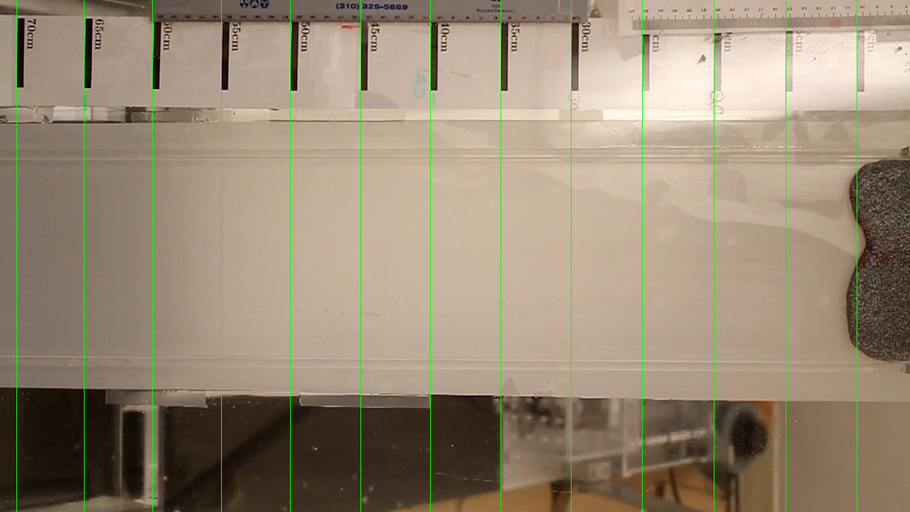
Automatic Ruler Line Detection

Slide 16
Image Analysis Techniques
Automatic Ruler Line Detection
  Edge Detection
  Image Registration on Binary Image
  Highest Percentile Considered Ruler Lines
Automatic Bi-Modal Thresholding
  Otsu's Method on Frame Gradient
  RGB Conversion to Grayscale
  Thresholds to Slurry and Non-Slurry (Ideally)

Slide 17
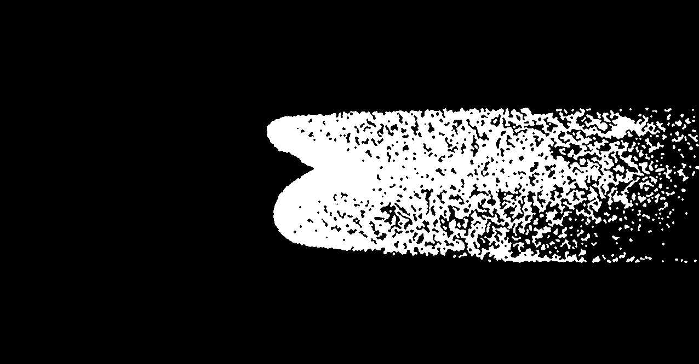
Automatic Bi-Modal Thresholding

Slide 18
Image Analysis Techniques
Automatic Ruler Line Detection
  Edge Detection
  Image Registration on Binary Image
  Highest Percentile Considered Ruler Lines
Automatic Bi-Modal Thresholding
  Otsu's Method on Frame Gradient
  RGB Conversion to Grayscale
  Thresholds to Slurry and Non-Slurry (Ideally)
Edge Detection for Settled Cases
  Canny Edge Detection
  Modified Thresholds to Eliminate Noise
  Detects Some Oil Fronts

Slide 19
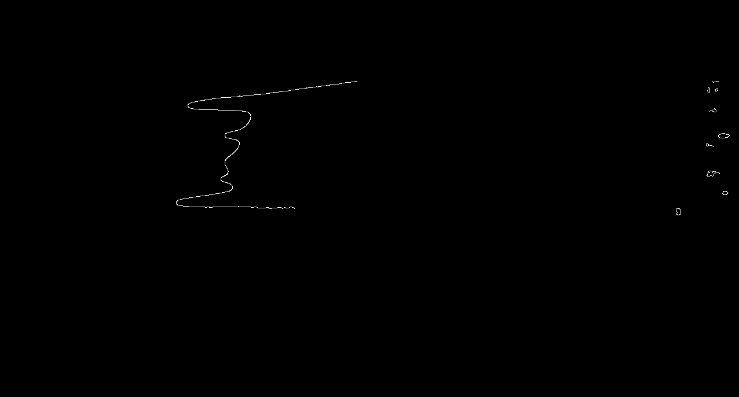
Edge Detection for Settled Cases

Slide 20
Plots of Numerical Results – Example MATLAB Output
Position Vs. Time Plot
Log Position Vs. Log Time Plot
  Exponent Calculated via Linear Fit
  Compare Exponent with Huppert Model (1/3)
Average Velocity (Command Window Output)
Example: 30 Degrees, 0.4 Volume Fraction, 25 GSB

Slide 21
Plots of Numerical Results:
Plots and Surfaces of Data
Percentage GSB vs. Average Velocity
Percentage GSB vs. Time Exponent
Percentage GSB Does Not Explain Variation in Either
Example: 0.4 Volume Fraction, 30 Degrees

Slide 22
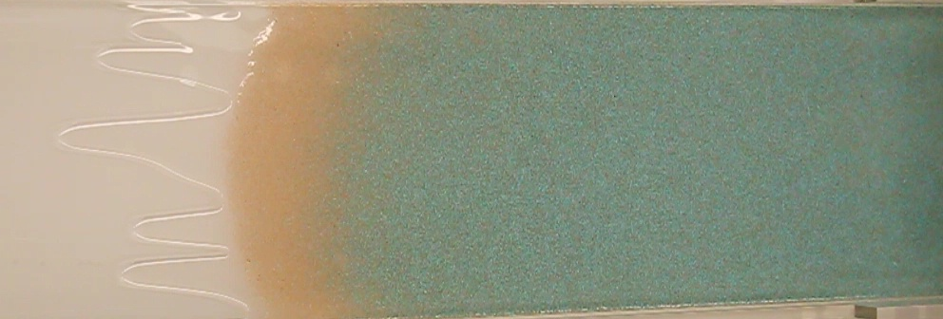
Concentration of Front
Averaged RGB values across slurry
Tracked GSB (red) and glass (blue) fronts
Similar plots to average front position
Compare well-mixed and separated regimes

Slide 23
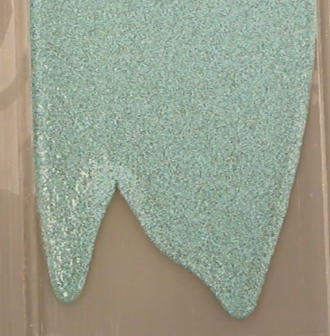
Well-mixed: 30 deg, 25% GSB
Exponent:
  GSB: 0.42
  Ceramic: 0.416

Slide 24
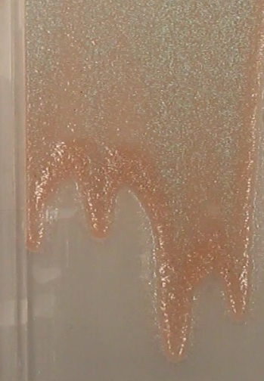
Separated: 30 deg, 75% GSB
Exponent:
  GSB: 0.404
  Ceramic: 0.325

Slide 25
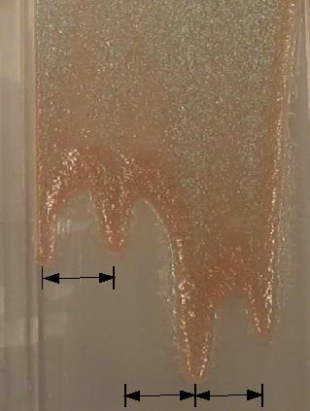
Average Wavelength
Average wavelength:
  Average distance between finger tips
Factors:
  Width of track: 14 cm
  Position of fingers
  Number of fingers
Mono-disperse/Bi-disperse results:
  Number of fingers: 2-6
  Wavelength range: 2 – 8.5 cm

Slide 26
Average Wavelength

Slide 27
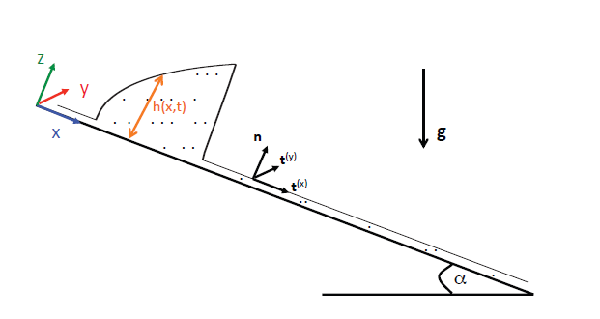
Modeling
We study flow on an incline consisting of negatively buoyant particles in a viscous suspending liquid.
Begin with Stokes equations for an incompressible variable-viscosity suspension and the conservation of total mass of particles.
Different timescales:
Z-direction: FAST
X-direction: SLOW
Assume particle distribution is
in equilibrium in z-direction
.

Slide 28
Two-phase Model
Balance of linear momentum:
Conservation of mass for particles:
Incompressiblity condition:
Particle Fluxes:
Shear-induced migration
Hindered settling of particles due to gravity
.

Slide 29
Lubrication Equations
The equations are scaled using the lubrication approximation:
Asymptotically expanding to leading order we then integrate with respect to z to obtain:
We use a similar approach on the momentum equation:
H
L
Shear stress
.

Slide 30
Mono-disperse Case
Ridged
Well-mixed
Settled

Slide 31
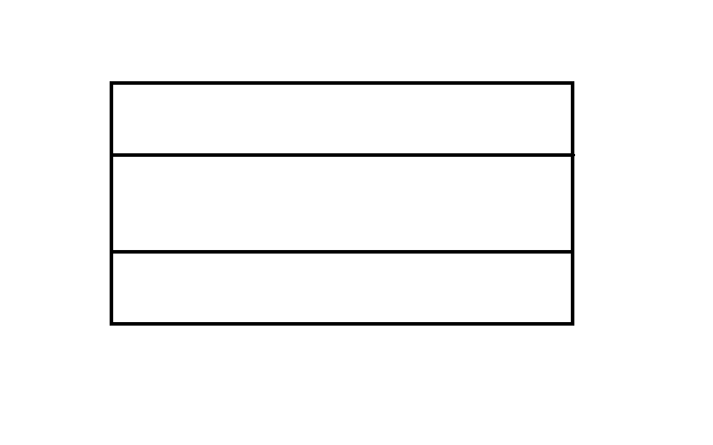
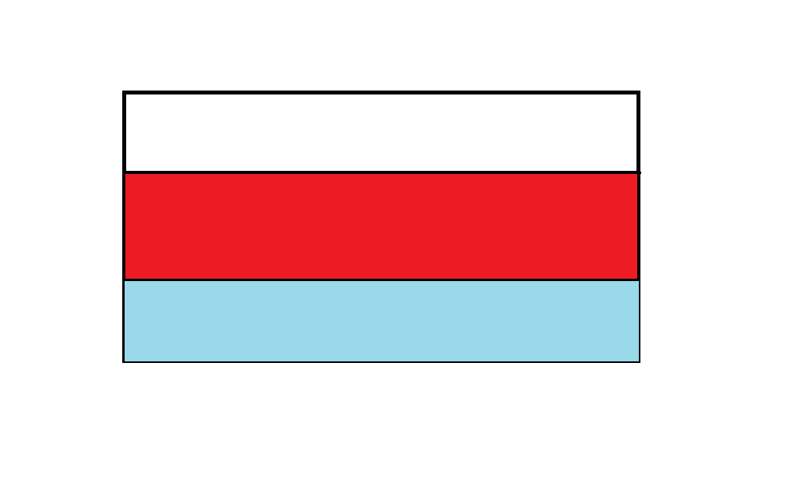
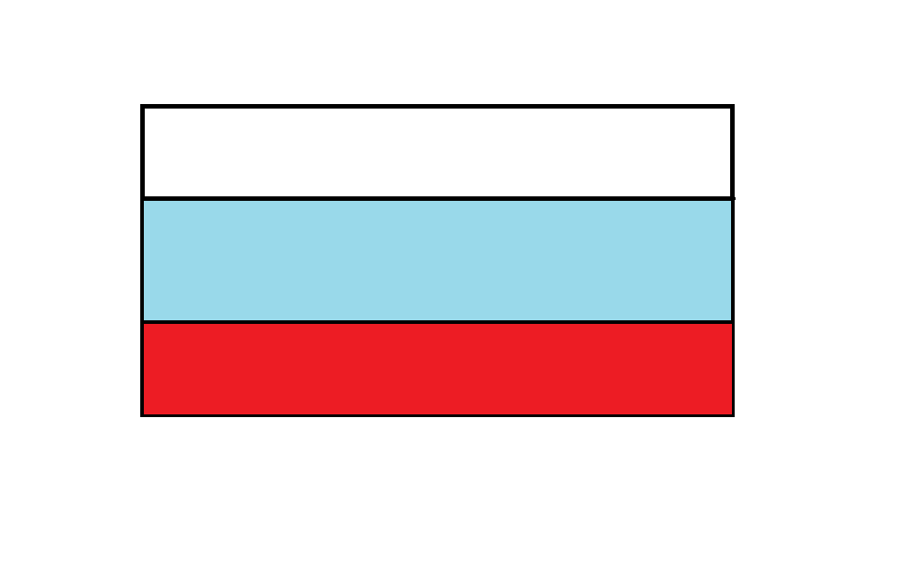
Bi-disperse Model
We assume a layered model for the settled regime with separation in the z-direction.
We consider two cases:
1. lighter particles on top
Match shear stress and velocity
Clear fluid
φ2
h2
φ1
h1
2. heavier particles on top
GSB
Ceramic
Ceramic
GSB

Slide 32
Numerical Simulations
h1 : ε…0.9
h2 : (h1 + ε)…(1 – ε)
The system of equations above are then solved for each h1 and h2 to give the total volume fraction, the velocity of each layer and various fluxes.
Repeat for each angle and then filter the data.
Is it possible to have the ceramic on top and the GSB moving faster?
Volume Fraction | Particle Ratio (GSB:Ceramic)
0.2 | 25:75
0.4 | 50:50
0.5 | 75:25

Slide 35
Conclusion
Relevant Results:
  Heavier ceramic beads migrate to the top of the flow
  Lighter glass beads travel faster down the track
  Ceramic beads induce separation
Future Work:
  Further develop model analyzing heavier beads on top of flow
  Run experiments with beads of different sizes

