Slide 1
Population Dynamics
Katja Goldring, Francesca Grogan, Garren Gaut, Advisor: Cymra Haskell

Slide 2

Iterative Mapping
We iterate over a function starting at an initial x
Each iterate is a function of the previous iterate
Two types of mappings
  Autonomous- non-time dependent
  Non-autonomous- time dependent

Slide 3
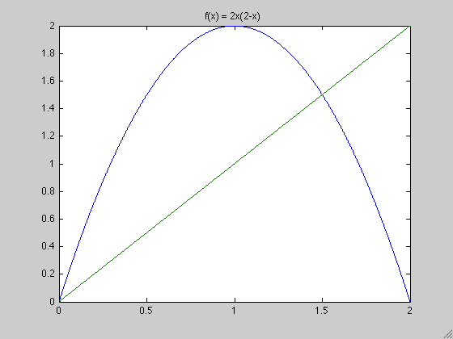
Autonomous Systems
Chaotic System- doesn’t converge to a fixed point given an initial x
A fixed point exists
wherever f(x) = x.
This serves as a tool for
visualizing iterations
fixed point
fixed point
Notes:
*Start with atonomous case , then go to non-autonomous case.
3

Slide 4

Stability

Slide 5

Autonomous Systems
Autonomous Pielou Model:
2
a1 = 0.500000
2
a1 = 2.000000
1.8
1.8
Carrying Capacity
1.6
1.6
1.4
1.4
1.2
1.2
1
1
0.8
0.8
carrying capacity
0.6
0.6
0.4
0.4
0.2
0.2
0
0
0.2
0.4
0.6
0.8
1
1.2
1.4
1.6
1.8
2
0
0
0.2
0.4
0.6
0.8
1
1.2
1.4
1.6
1.8
2
Notes:
The carrying capacity of a population is the maximum population size of the species that the environment can sustain indefinitely given food, space, and other necessities available in the environment.
The growth rate of a population below the carrying capacity is positive, after it becomes negative due to overpopulation of the environment.
Here, the carrying capacity is a stable fixed point, which makes sense since populations will be at their optimal size at the carrying capacity.

Slide 6

Autonomous Systems
Autonomous Sigmoid Beverton Holt:
Allee Threshold
Notes:
Unlike most classical dynamical systems, which exhibit a negative density dependence, the allee effect dictates that populations with a low density will have a low growth rate (ie it will die out).
Graph: any initial population below ~.4 will die out
Examples: flour beetles, some freshwater fish, flowering trees

Slide 7



Graphs
Notes:
Examples of Autonomous Case of Sigmoid Beverton Holt.
7

Slide 8


Graphs
Notes:
8

Slide 9


Graphs

Slide 10
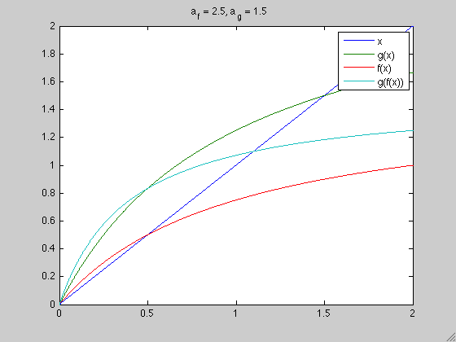

Non-Autonomous Systems
Pielou Logistic Model
Notes:
Beverton Holt-Model- A logistic difference equation developed in 1957 as an alternative to an exponential model. Ie. Fish population dynamics, especially when overfishing is present.
*Explain how fixed point of composition is periodic orbit for sequence.
10

Slide 11
Semigroup
A semigroup is closed and associative for an operator
We want a set of functions to be a semigroup under compositions
A fixed point of a composed function is an orbit for a sequence of functions
Notes:
Beverton Holt-Model- A logistic difference equation developed in 1957 as an alternative to an exponential model. Ie. Fish population dynamics, especially when overfishing is present.
*Explain what iterating function is.
*Why do we call it a carrying capacity?
*Explain how fixed point of composition is periodic orbit for sequence.
11

Slide 12
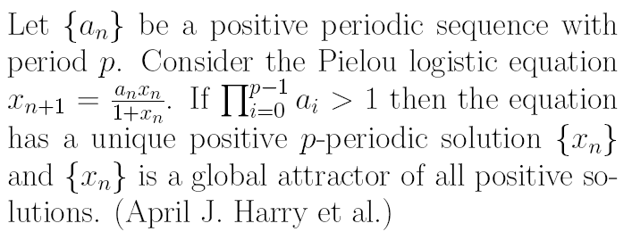
Known Results
Notes:
*Now talking about p-periodic non-autonomous systems.
*Cant expect to get a fixed point for non-autonomous case.
*explain similarities and differences between this and next slide
12

Slide 13
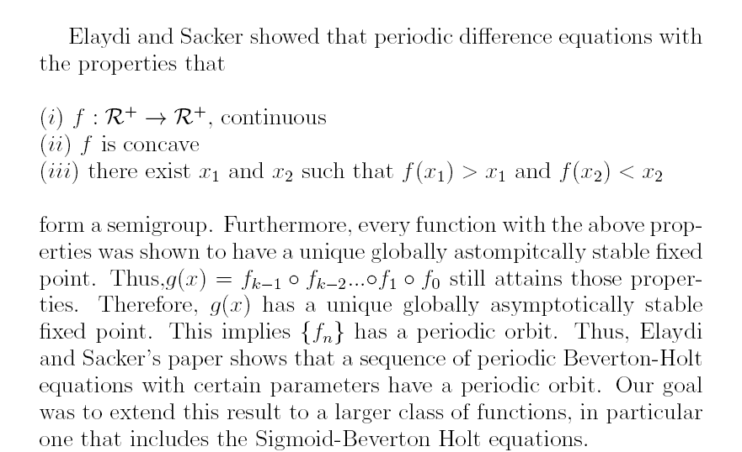
…Known Results
Notes:
*Explain how fixed point of composition is periodic orbit for sequence.
*make sure to say “Beverton Holt” and not Sigmoid Beverton Holt.
*explain similarities and differences between this and one slide before
*asymptotically stable is spelled wrong
13

Slide 14
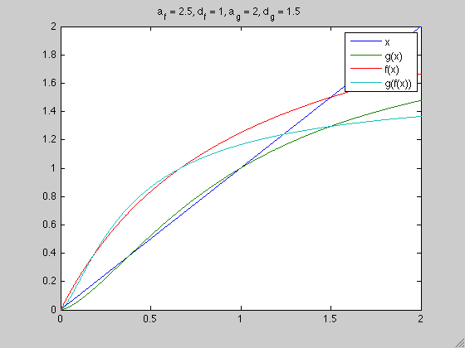

An Extended Model
Sigmoid Beverton-Holt Model
Notes:
The Sigmoid Beverton-Holt model is a variation of the Beverton-Holt model. At delta = 1, the model is equivalent to the Beverton-Holt model. This model is important because for particular parameters, the model exhibits the allee affect, which is a positive relationship between growth rate and population densities.
14

Slide 15
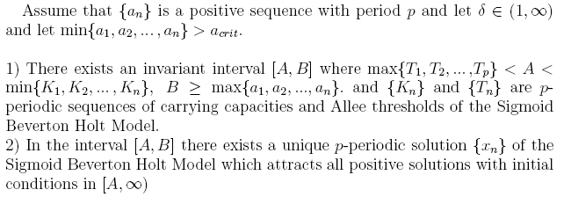
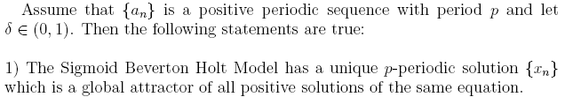
Known Results
Notes:
Similar to results of pielou. We are reproducing and extending these results (our proof is a lot cleaner?).
Notice :They are varying only a_n, delta is constant. Later: say that we are varying both a_n and delta.
15

Slide 16

Our Model
Sigmoid Beverton-Holt Model with varying deltas and varying a’s.
Goal: We want to show that there exists a non-trivial stable periodic orbit for a sequence of Sigmoid Beverton-Holt equations with varying a’s and varying deltas.
Notes:
*with var
16

Slide 17
Problems
We know a non-trivial periodic orbit doesn’t exist for certain parameters, even in the autonomous case
How to group functions for which we know an orbit exists
Can we make a group of functions closed under composition?

Slide 18

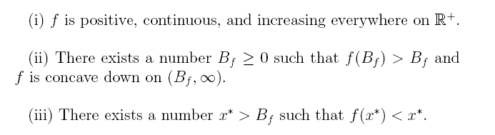

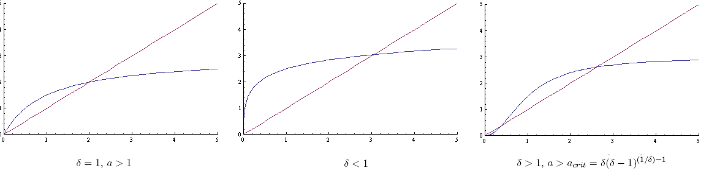
Notes:
Explain how it is important that it only needs to look a certain way from some point onwards. (Chalkboard?)
18

Slide 19
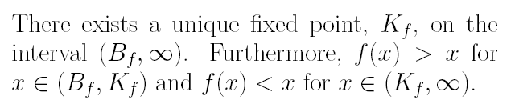

Lemmas
Notes:
*make sure you’ve explained diagonal by this point. Done (we can explain this verbally)
*make sure you’ve explained stability by this point. Done.
*show why this isn’t closed under composition. (example?)
19

Slide 20

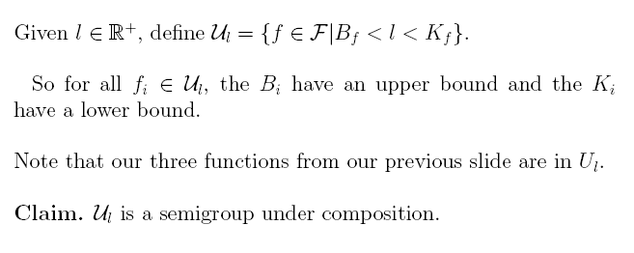


Notes:
Why do the B_i and the K_i have to be seperated?
20

Slide 21
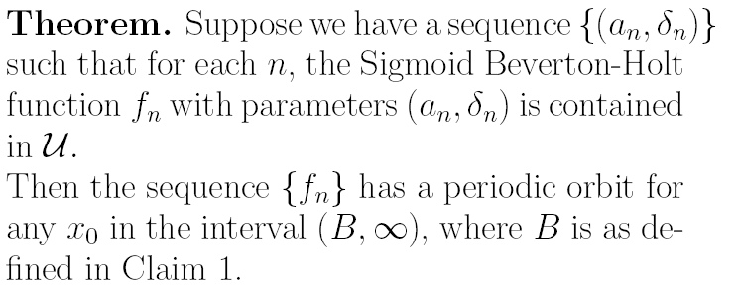
Application to model

Slide 22
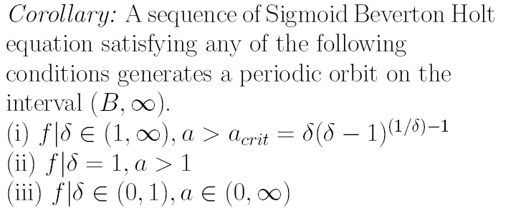
Corollary
Notes:
*A periodic, non-autonomous system of S.B.H where each function is one of the following three….. & B_i<l<K_i
*These are new results, since the a_n are varying and the deltas are varying.
22

Slide 23
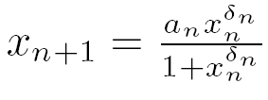


The Stochastic Sigmoid Beverton Holt
We are now looking at the same model,
except we now pick our and randomly at each iteration.

Slide 24

Density
A probability density function of a continuous random variable is a function that describes the likelihood of a variable occurring over a given interval.
We are interested in how the density function on the
evolves. We conjecture that it will converge to a unique invariant density. This means that after a certain number of iterations, all initial densities will begin to look like a unique invariant density.

Slide 25

Stochastic Iterative Process
We iterate over a function of the form
where the parameters
are chosen from independent distributions.

Slide 26





Stochastic Iterative Process
At each iterate, n, let denote the density of
,, and let denote the density of
  For each iterate is invariant, since we are always picking our from the same distribution.
  For each iterate can vary, since where
  falls varies on every iterate.
Since the distributions for and are independent, the joint distribution of and is

Slide 27


Previous Results
Haskell and Sacker showed that for a Beverton-Holt model with a randomly varying environment, given by
there exists a unique invariant density to which all other density distributions on the state variable converge.
This problem deals with only one parameter and the state variable.

Slide 28
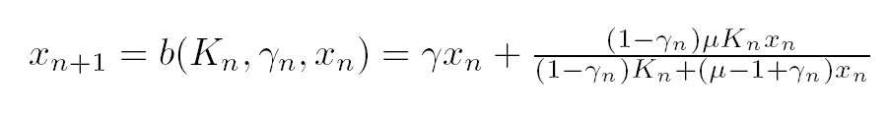

…more Previous Results
Bezandry, Diagana, and Elaydi showed that the Beverton Holt model with a randomly varying survival rate, given by
has a unique invariant density.
Thus they were looking at two parameters, and the state variable.

Slide 29
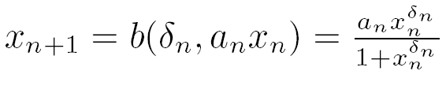

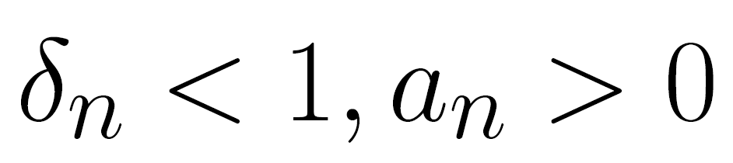
Stochastic Sigmoid Beverton Holt
We examine the Sigmoid Beverton Holt equation given
by
We’d like to show that under the restrictions
there exists a unique invariant density to which all other density distributions on the state variable converge.

Slide 30
Our function

Slide 31





Our Method of Attack
We have
where is a Markov Operator that acts on densities.
We found an expression for the stochastic kernel of . , where

Slide 32
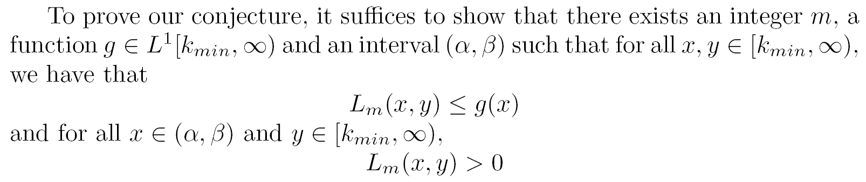

Method of Attack Continued
Lasota-Mackey Approach:
The choice of depends on what restrictions we put on our parameters. We are currently refining these.

Slide 33
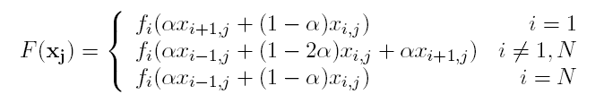

Spatial Considerations
1-dimensional case where populations lie in a line of boxes:
Goal: See if this new mapping still has a unique, stable, nontrivial fixed point.

Slide 34
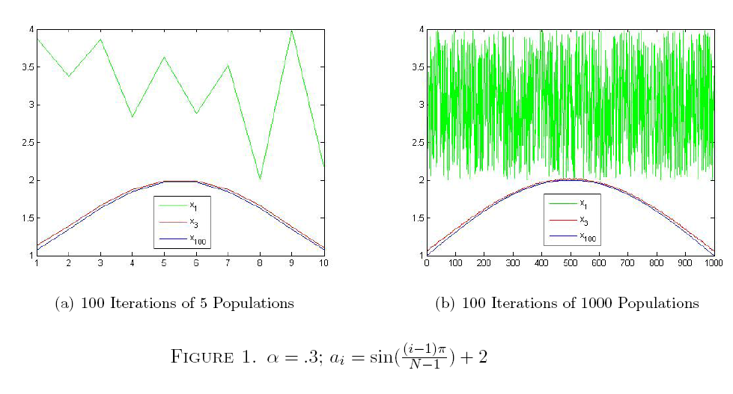
MATLAB visualizations

Slide 35
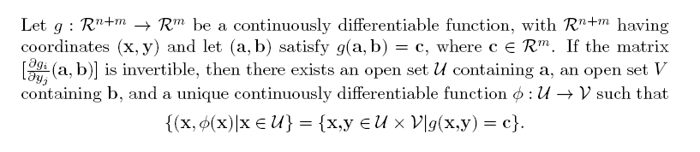
Implicit Function Theorem
We can use this to show existence of a fixed point in F.

Slide 36
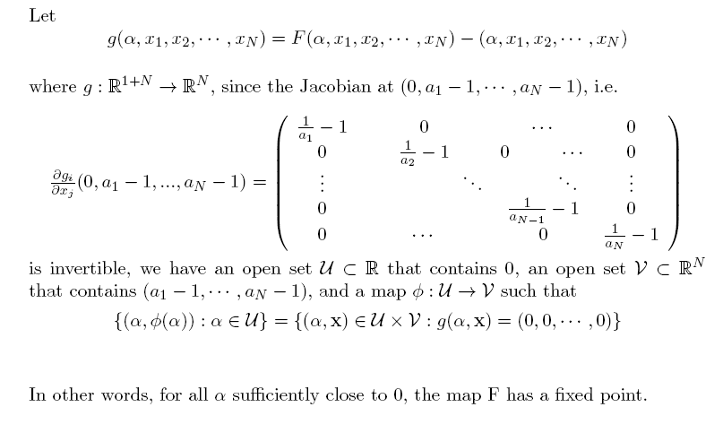
Application to Spatial Beverton-Holt

Slide 37
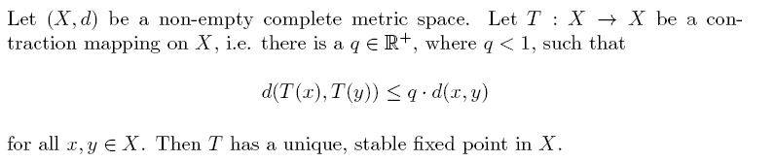
Banach Fixed Point Theorem
The previous theorem only guaranteed existence of fixed point, whereas if we prove our map is a contraction mapping, we can get uniqueness and stability.

Slide 38
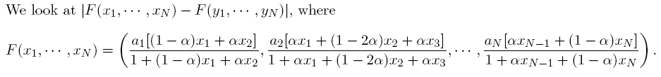
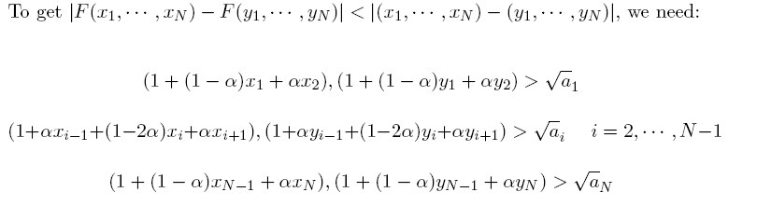
Application to Spatial Beverton-Holt

Slide 39
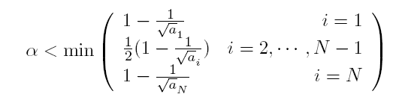

Application to Spatial Beverton-Holt
The conditions on the previous slide form half-planes. We need to show the intersection of these planes is invariant under F. We found this is the case when
Therefore F is a contraction mapping on when the above conditions are satisfied, and F has unique, stable fixed point on .

Slide 40
Future Work
Finish the proof that the Sigmoid Beverton Holt model has a unique invariant distribution under our given restrictions.
  Expand this result to include more of the Sigmoid Beverton Holt equations.
Contraction Mapping: Prove there exists a q<1 such that

Slide 41
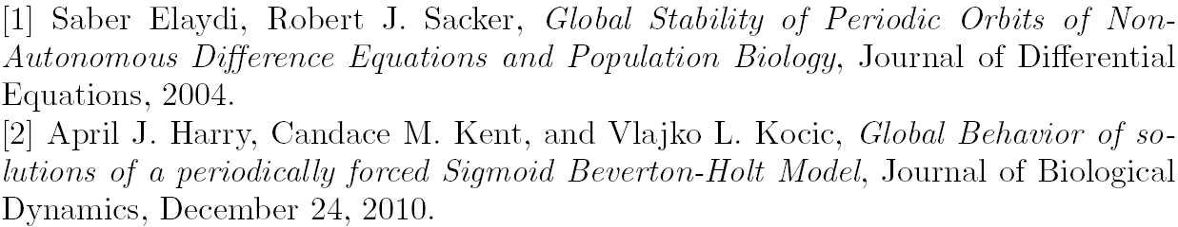
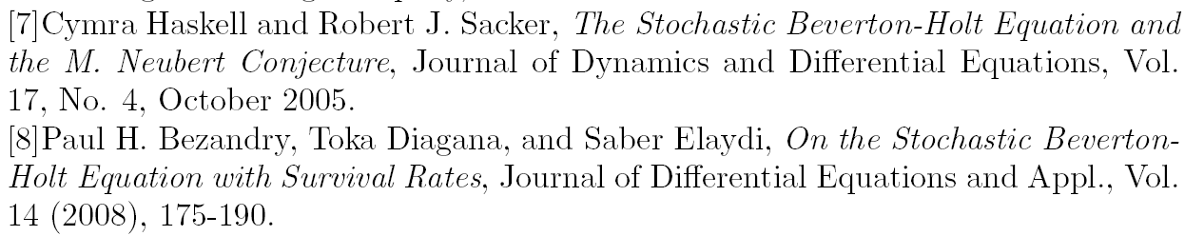
References

Slide 42
Thanks to
Our advisor, Cymra Haskell.
Bob Sacker, USC.
REU Program, UCLA.
SEAS Café.

