Slide 1
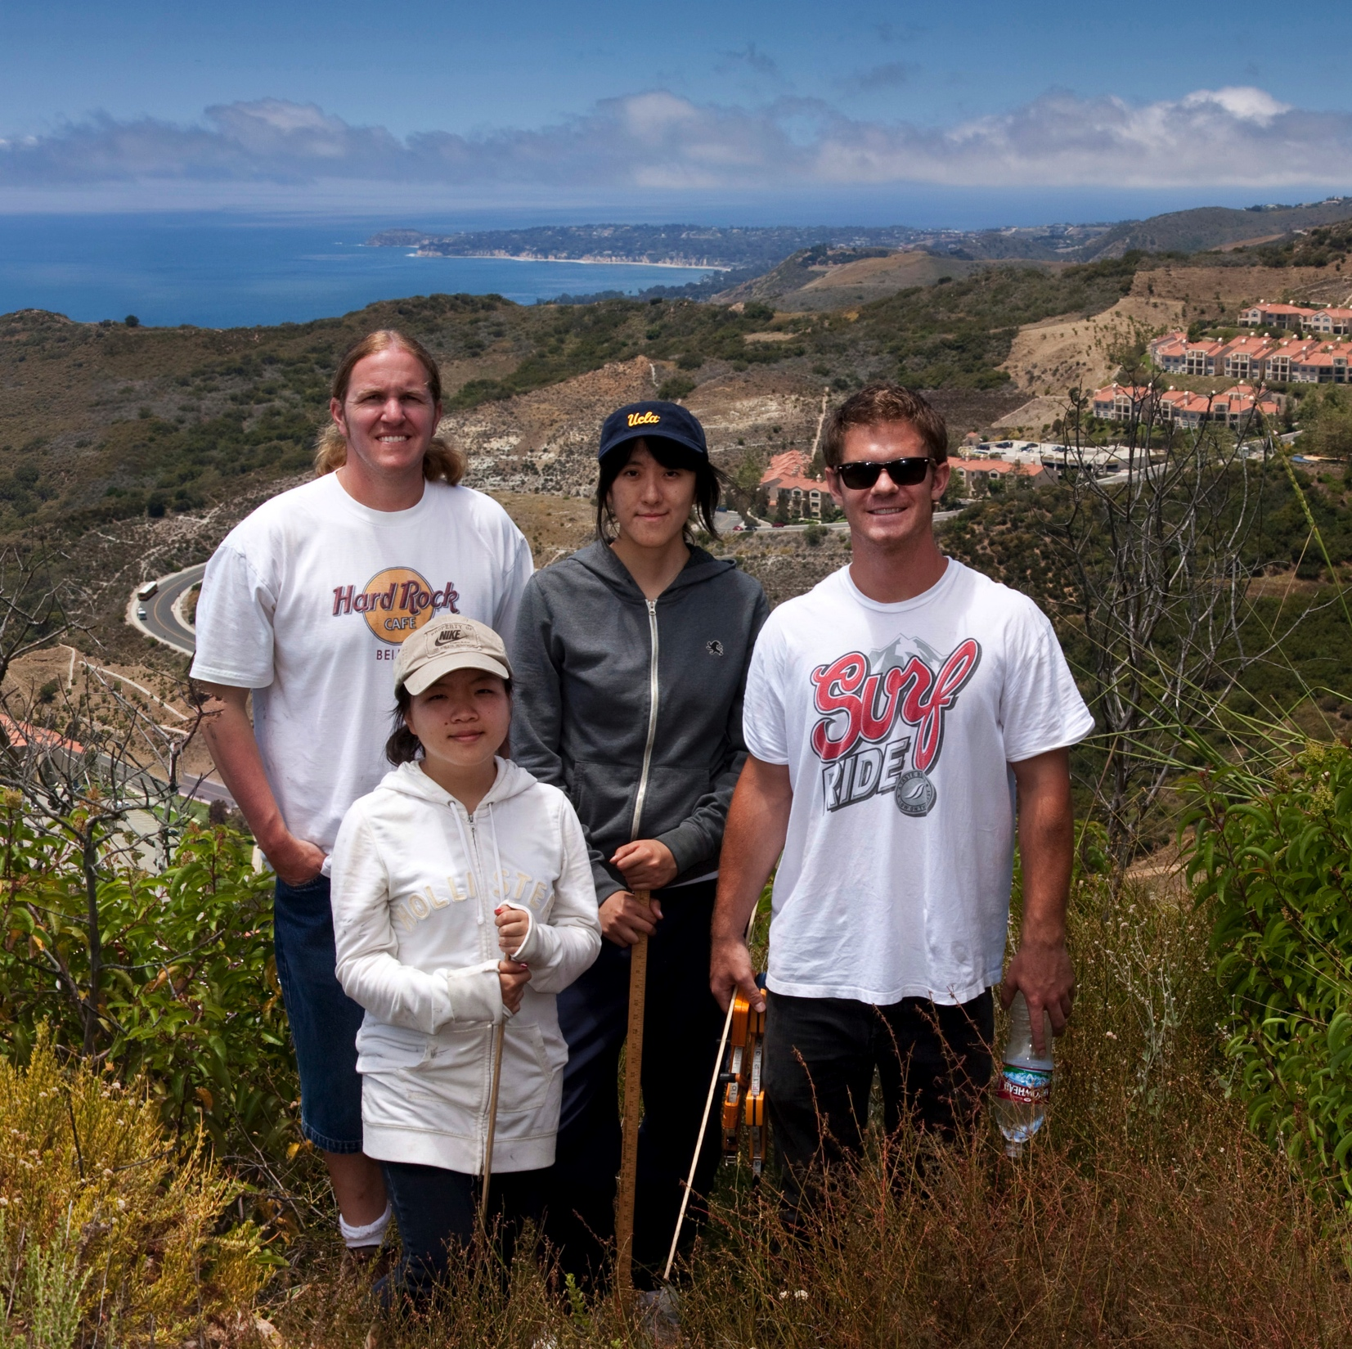
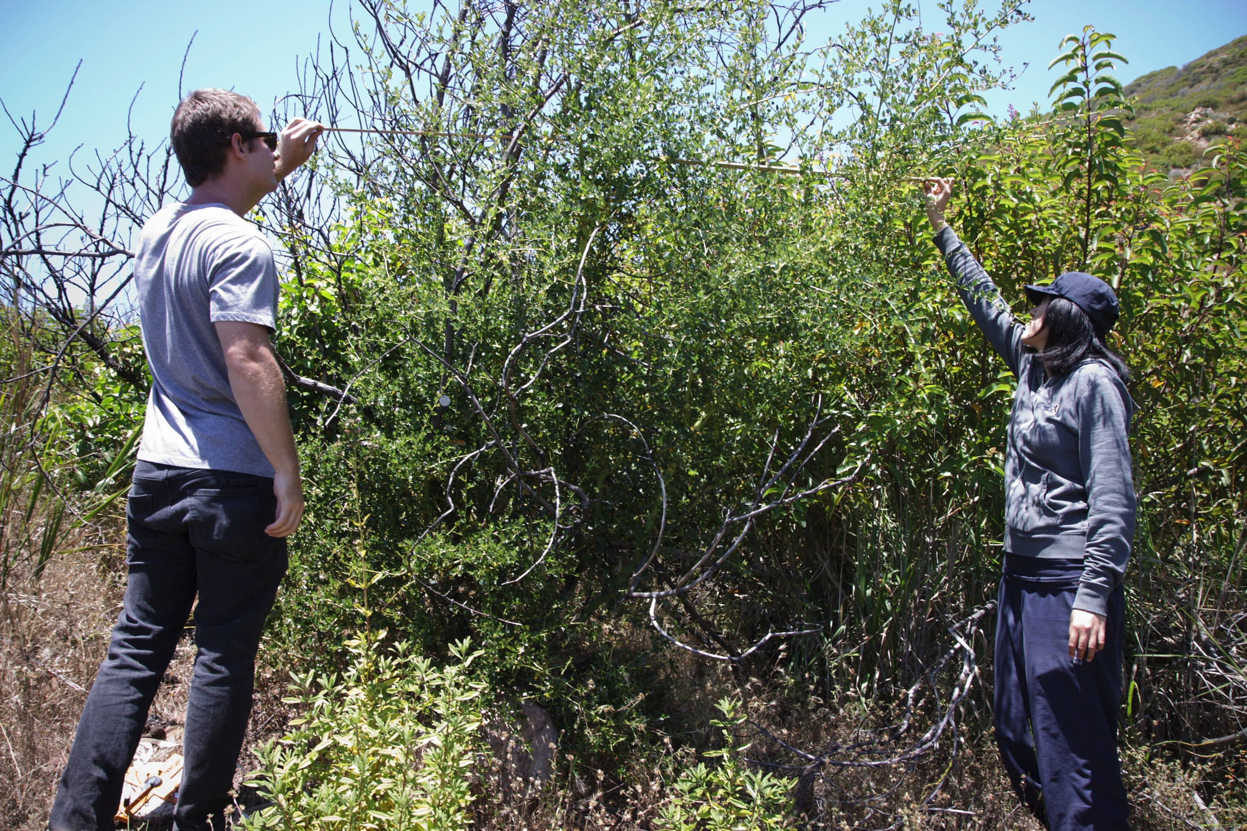
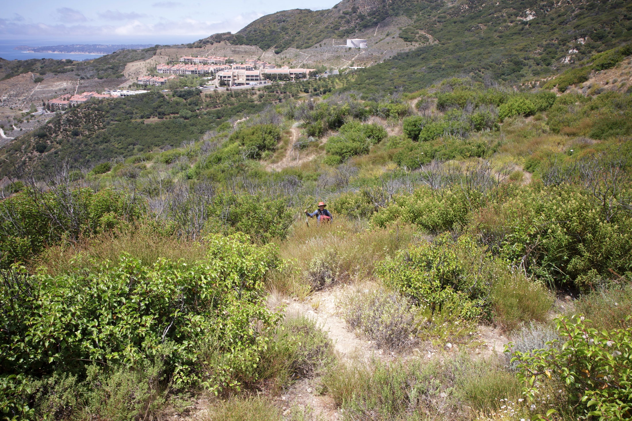
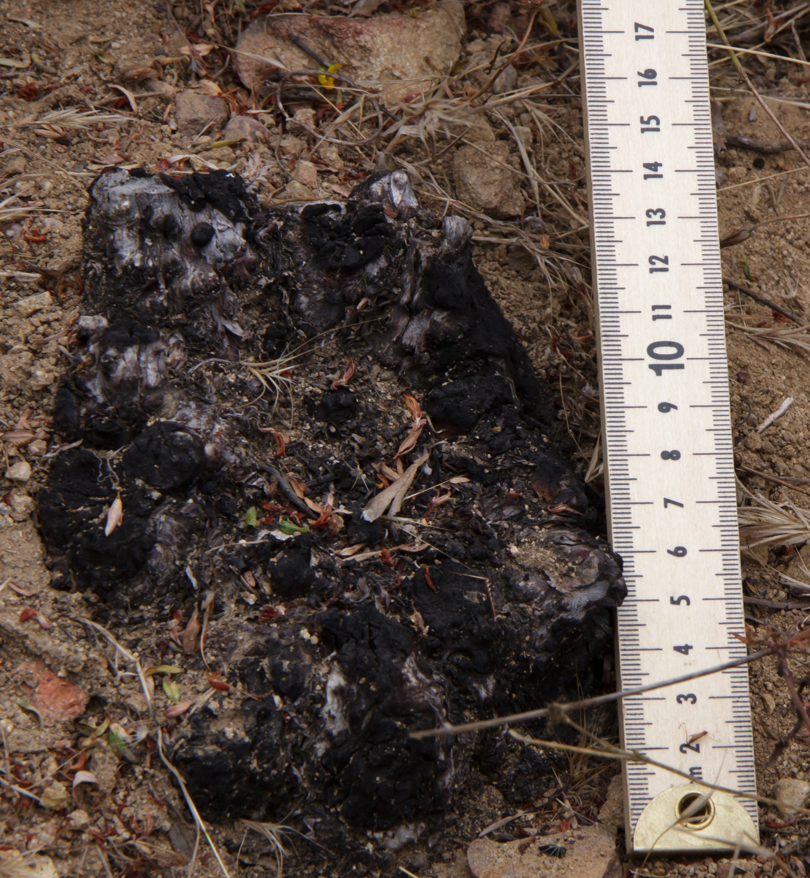
Chaparral Population Models in Response to Wildfire
Wancen Jiang, Garrett Johns, and Luci Yang

Slide 2
Why is Fire Frequency Important?
Increased fire frequency in the Santa Monica Mountains (SMM).
1925-2001: Average Time Between Fire (ATBF) 32 years.
1985-2011: Local ATBF has been just over 6 years.
Transforming the landscape of SMM.
Localized extinction of particular plant species.
Accelerating erosion, thus weakening manmade structures.
“13% of this fire-prone area is developed.”

Slide 3
The Three Chaparral Types
Non-Sprouters (NS)
Completely killed by fire, but reproduce by seeds that germinate in response to fire.
Obligate Sprouters (OS)
Completely destroyed by fire (including seeds), but subsist vis-à-vis their deep roots wherefrom they re-sprout.
Facultative Sprouters (FS)
Re-sprout and reproduce vis-à-vis roots and seeds that survive fire.

Slide 4
Population Cycle (NS)
Seeds
Mature plants release seeds annually.
Seeds germinate into younglings post-fire.
Mature
Young
Younglings are promoted to Mature.

Slide 5
Assumptions (NS Model)
Events occur on an annual basis.
Fire occurs with a probabilistic frequency.
Fire destroys all younglings and mature plants.
Mature plants release seeds annually.
Seeds germinate into younglings at a set rate.
Seeds are predated at a set rate.
Younglings are promoted to Mature plants after 6 years.

Slide 6
Assumptions (NS Model cont’d)
Younglings undergo logistic decay.

Slide 7
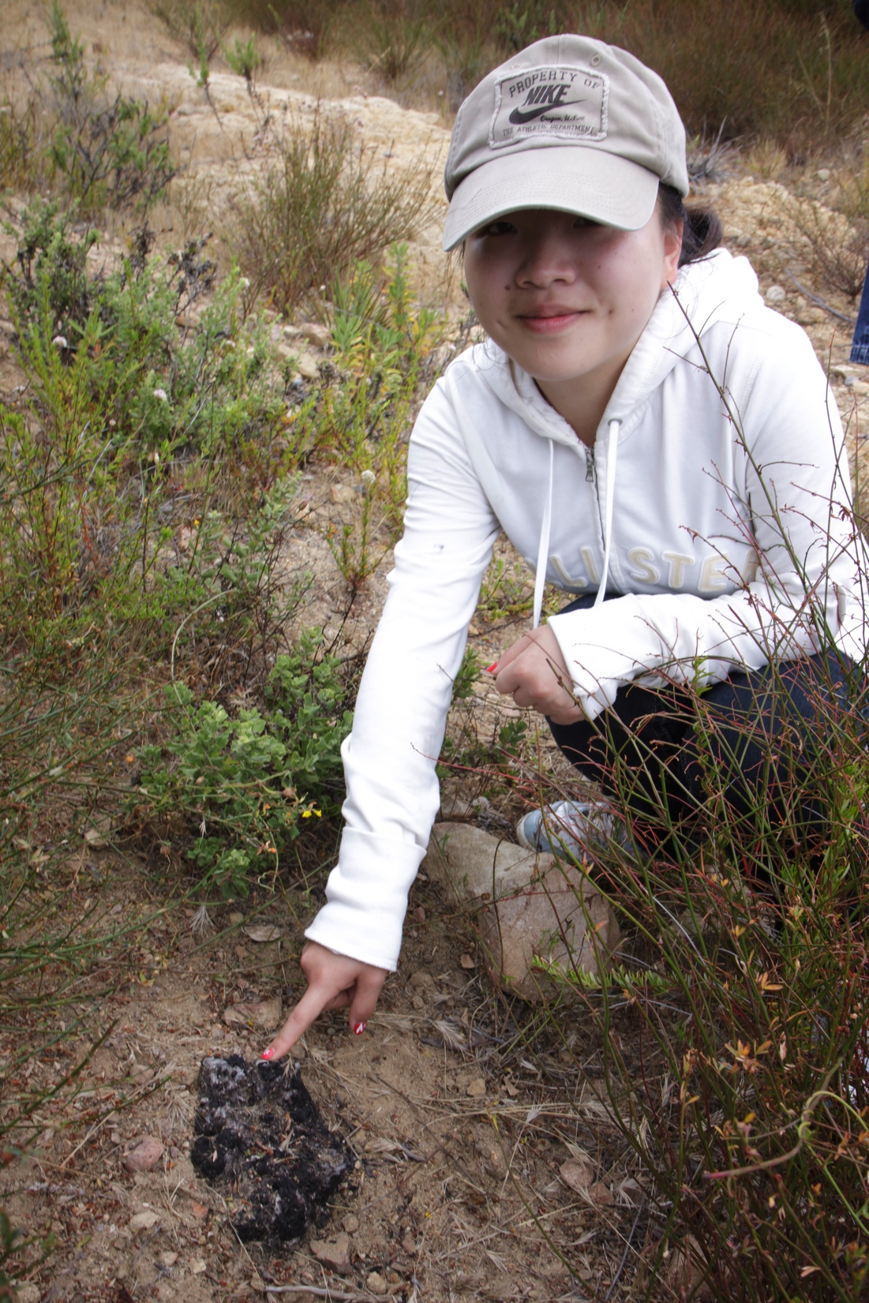
NS Model
Pre-Fire
Post-Fire

Slide 8
NS Model

Slide 9
NS Model

Slide 10
NS Model

Slide 11
NS Model

Slide 12
NS Model

Slide 13
NS Model

Slide 14
NS Model Parameter Study
Seeds and mature plants approach a limit.
Younglings reach carrying capacity before promotion.
The mature population is stable when:
Notes:
If we allow seedlings and mature plants to approach a limit…there is no fire and younglings are promoted after they reach carrying capacity…the seedbank will take on value…the mature population will be equal to the youngling carry capacity, which is always a fraction of the germinated seedbank. So the mature population will be in equilibrium when the product of the following is one.

Slide 15
NS Model Parameter Study
Notes:
We varied certain parameters against each other to test this relationship. When seed release rate was tested against germination rate, even at different predation rates, the above behavior was noted. Slopes were always betweeen .95 and 1, experimentally validating our hypothesis.

Slide 16
NS Model Parameter Study
Notes:
Notice that when the value of k was compared to the product of the other parameters, the inverse relationship also held. However, notice the concavity when lower values of alpha were present. This implies that the faster we reach the carrying capacity, the more often we will obtain equilibriums.

Slide 17
Population Cycle (FS and OS)
FIRE
Re-Sprouts
Seeds
Mature and Re-Sprouts release seeds annually.
Seeds germinate into younglings.
FIRE
Mature
Young
Younglings are promoted to Mature.

Slide 18
Assumptions (FS and OS Model)
Vegetative re-sprouts proliferate after fire.
Re-sprouts release seeds annually post-fire.
The re-sprout release rate grows to a limit.
Re-sprouts also die logistically.

Slide 19
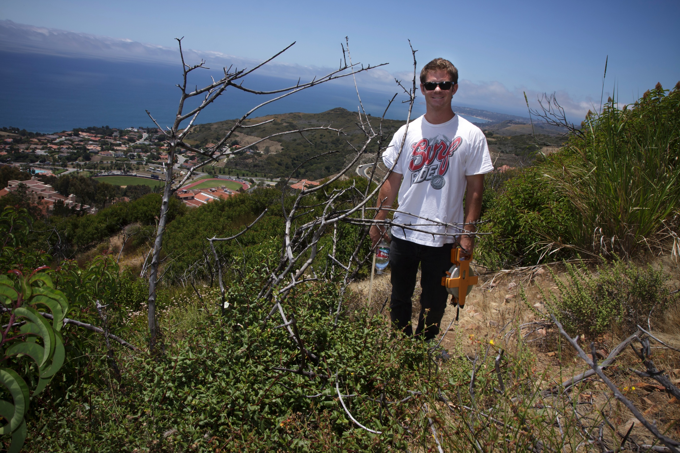
Obligate Sprouters (OS)
Pre-Fire
Post-Fire

Slide 20
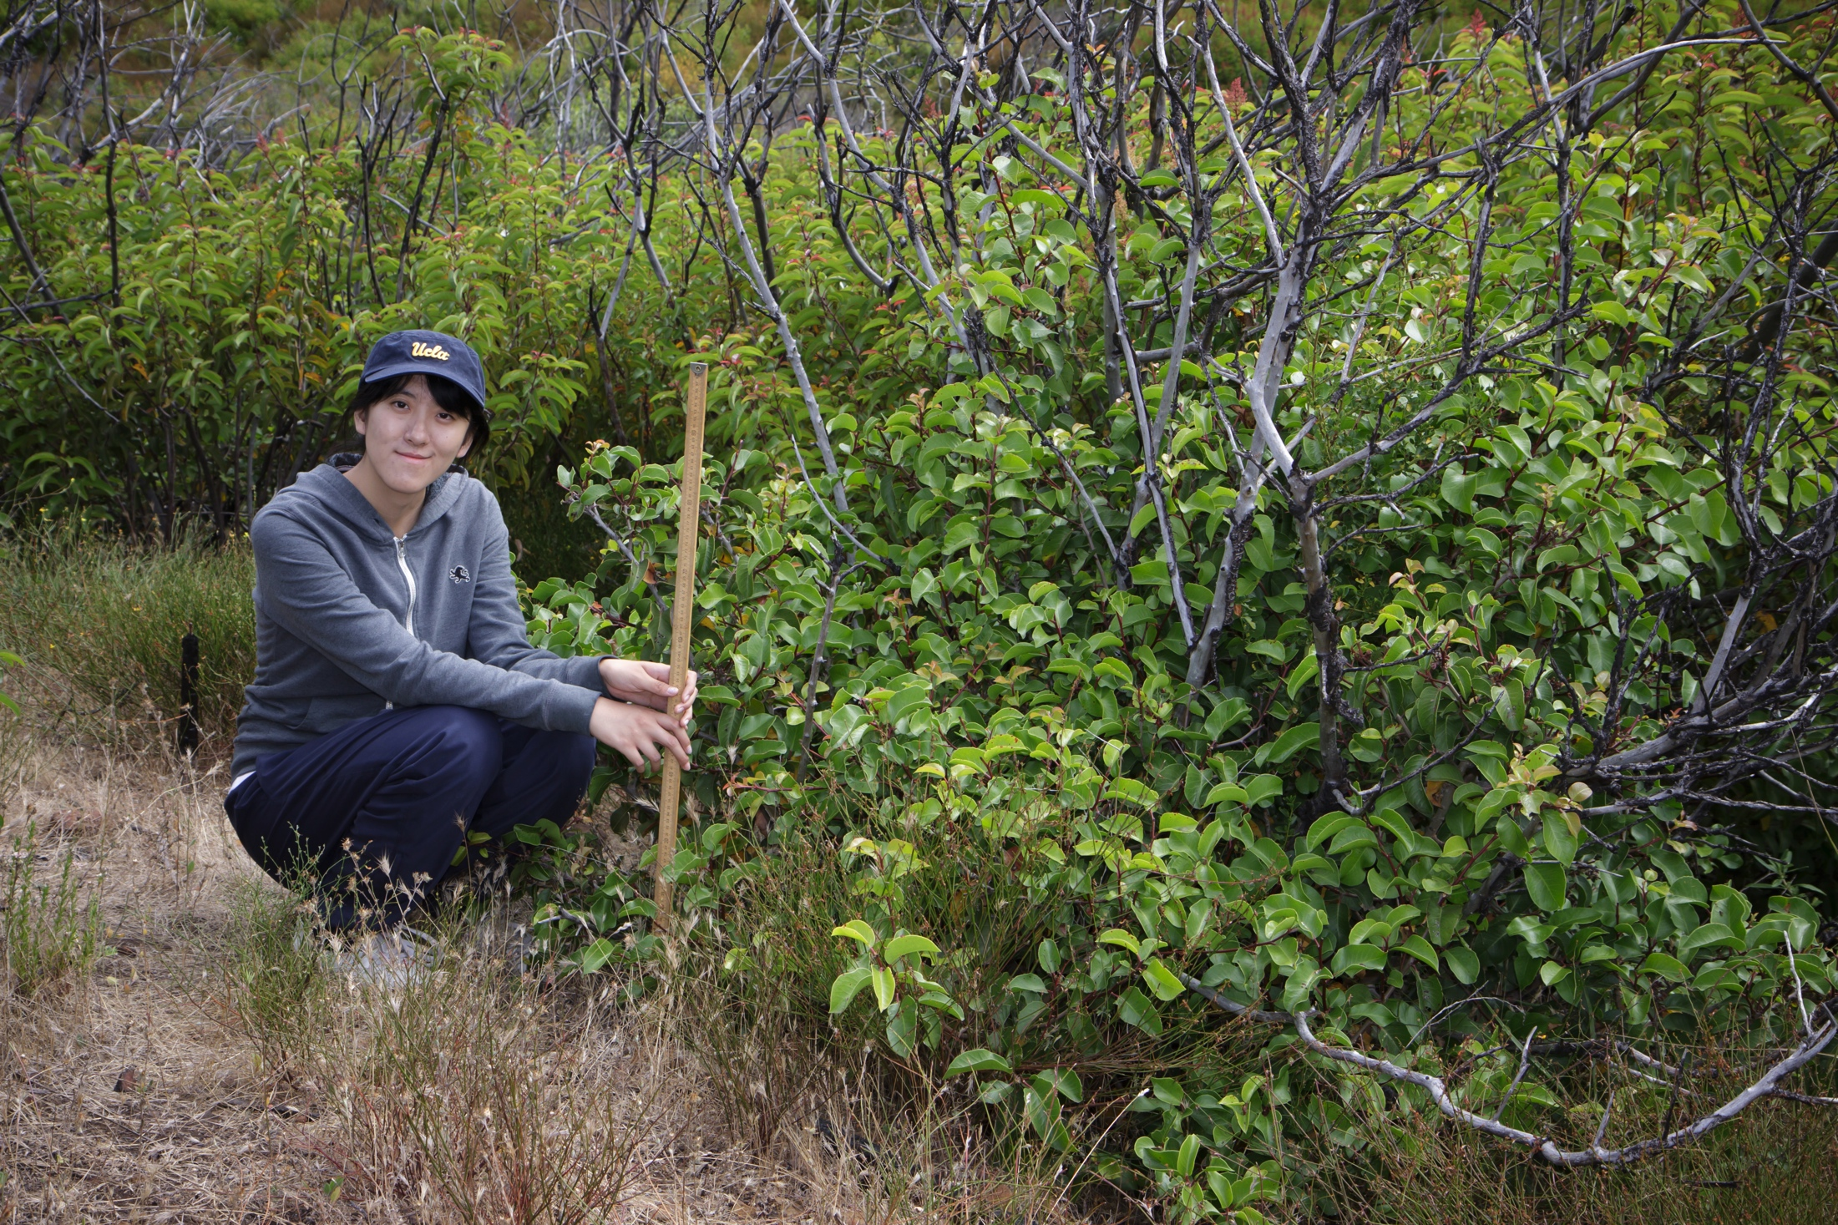
Facultative Sprouters (FS)
Pre-Fire
Post-Fire

Slide 21
FS Model (Ceanothus spinosus)

Slide 22
FS Model (Ceanothus spinosus)

Slide 23
FS Model (Ceanothus spinosus)

Slide 24
FS Model (Ceanothus spinosus)

Slide 25
FS Model (Ceanothus spinosus)

Slide 26
FS Model (Ceanothus spinosus)

Slide 27
FS Model (Malosma laurina)

Slide 28
FS Model (Malosma laurina)

Slide 29
FS Model (Malosma laurina)

Slide 30
FS Model (Malosma laurina)

Slide 31
FS Model (Malosma laurina)

Slide 32
FS Model (Malosma laurina)

Slide 33
Field Data

Slide 34
Plant Size
Facultative Sprouters
Malosma laurina
Resprouts dominate landscape post-fire.
Largest chaparral shrub.
Rhus ovata
Average-sized shrub.
Ceanothus spinosus
Average-sized shrub.
Non-Sprouter
Ceanothus megacarpus
Comparatively small shrub.

Slide 35
Spatial Program Design
Plant Class
Plant Attributes
Age, Species, Location, Size
Plant Parameters
Growth curves with parameters drawn from distrubtion
Survival rates for seedlings and resprouts
Member Functions
Grow
Collide
Resprout
Death

Slide 36
Plant Grid Class
Store each plant to an indexed pole location.
Check for crowding and shading by comparing plants at neighboring poles.
Plants are plotted from the grid class.

Slide 37
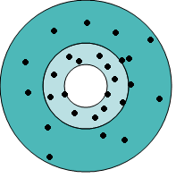
Seedbank Class
Add seeds to the seedbank
Seeds are dispersed by plants on grid
Radius and angle drawn from distribution.
Seeds are predated prior to germination.
Germinate seeds after fire
New plants assigned to indexed pole on grid.
Removing all non-germinated seeds from seedbank.

Slide 38
Spatial Simulation
Initial Distribution of Plants

Slide 39
Spatial Simulation
Seedlings Germinated Post-Fire

Slide 40
Spatial Simulation
Plants One Year Post-Fire

Slide 41
Spatial Simulation
Plants Two Years Post-Fire

Slide 42
Spatial Simulation
Plants Three Years Post-Fire

Slide 43
Spatial Simulation
Plants Four Years Post-Fire

Slide 44
Spatial Simulation
Plants Five Years Post-Fire

Slide 45
Spatial Simulation
Plant Crowding

Slide 46
Future Work
Competition between plant types.
Finish parameter study for FS model.
Estimate more parameters for the spatial model
e.g. Seed dispersal (distance)
Identify mechanisms that contribute to plant death.
Shading, crowding, water stress tolerance.
Optimize spatial model routines.

Slide 47
Bibliography
Acknowledgements…
Dr. Davis for providing study site and data, Dr. Bertozzi, and Dr. Lucas

Slide 48
Seeds
Mature plants release seeds annually.
Seeds germinate into seedlings post-fire.
Mature
Seedlings
Seedlings are promoted to Mature.

Slide 49
FIRE
Resprouts
Seeds
Mature plants and resprouts release seeds annually.
FS seeds germinate into seedlings post-fire.
FIRE
Mature
Seedlings
Seedlings are promoted to Mature.

