Slide 1
Data Storage Networks
Researchers:
Preet Bola
Mike Earnest
Kevin Varela-O’Hara
Han Zou
Advisor:
Walter Rusin

Slide 2
What to expect
Understanding the problem
Network representation
Terminology
Optimization algorithm & examples
Optimal File Arrangements:
Genetic Algorithm
Node Scoring Algorithm
Comparing Results
Solutions to Node Failures and Broken Networks
GUI Demonstration

Slide 3
The File Allocation Problem
In a computer network, not every computer has every file
Capacity constraints prevent this
The network comprises several servers, joined by network connections
Each server is connected to several users, whom each wants to download different files at different times
What arrangement of files allows the average download time to be the lowest?
Depends on how the computers are connected and average number of people at each computer who want each file

Slide 4
Our Model

Slide 5
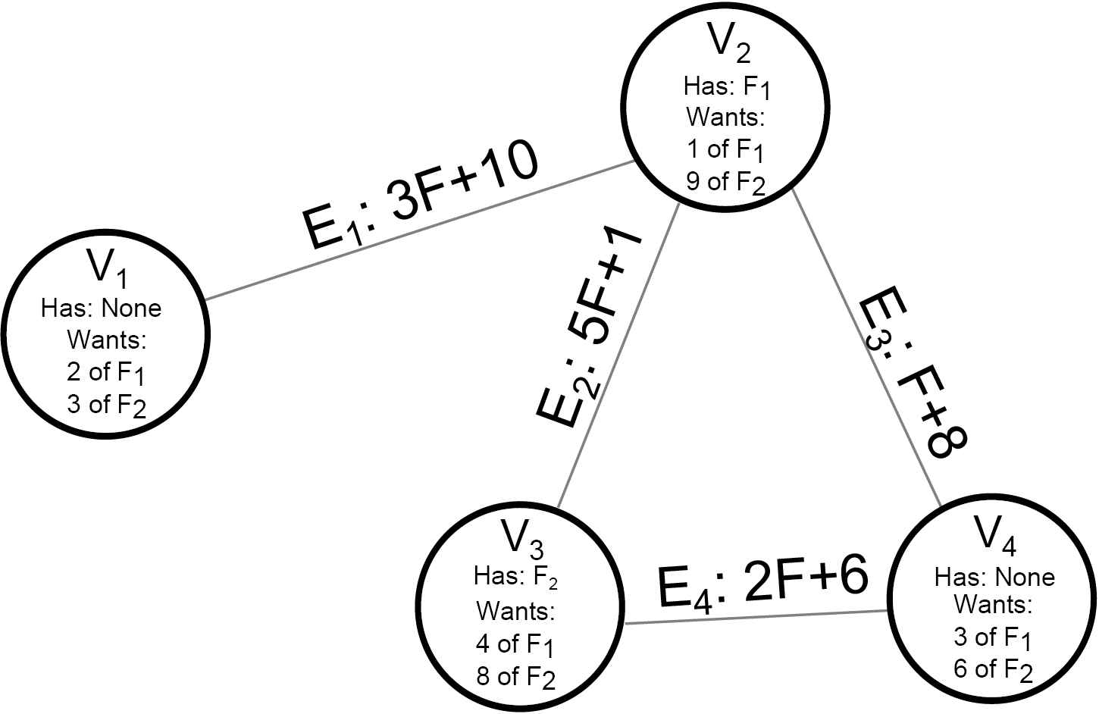

Slide 6
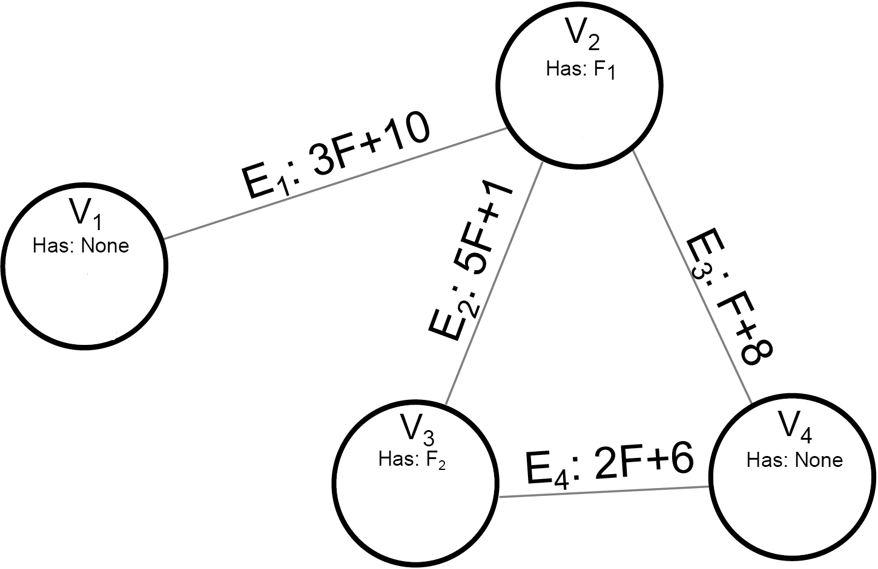
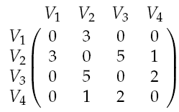
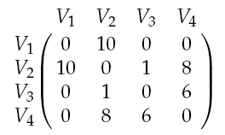
Our Model
We give each connection a bandwidth, a function which determines the time it takes to send data
The time it takes a file to pass through a connection is:
T = m*Files + b
N-node network is represented by two N by N matrices, one for slopes, one for constants
Coefficients
Constants

Slide 7
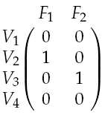
Our Model
If there are F files in the network, we represent the files’ locations with an N by F matrix, (i,j) entry is 1 if file j is at node i, 0 otherwise
Capacity: Each node can hold a maximum of C files

Slide 8
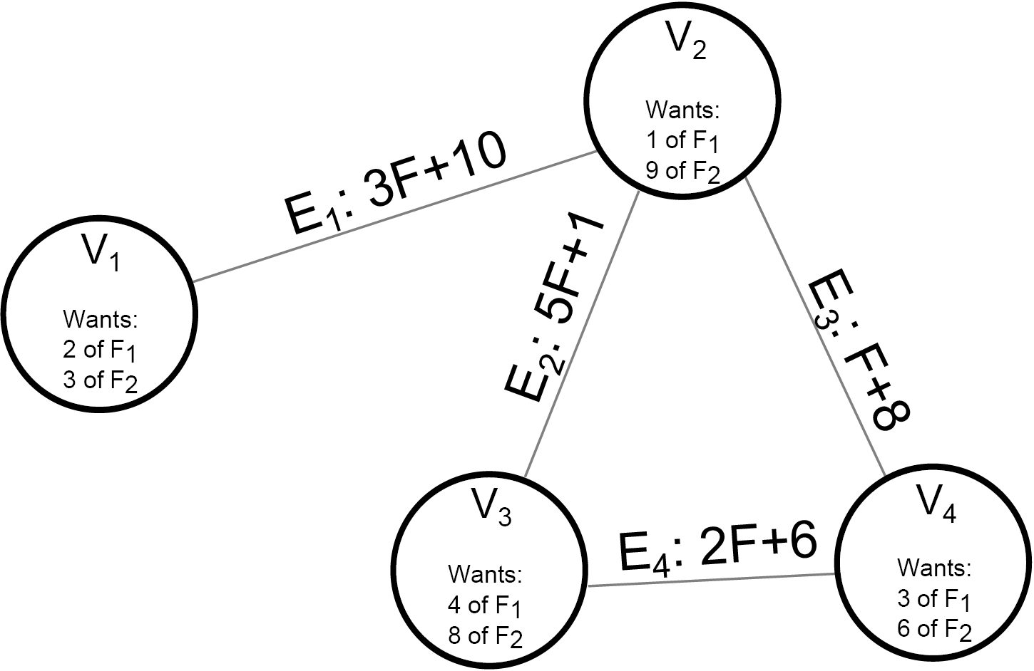
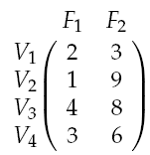
Our Model
The N by F Demand matrix is the number of people at node i who want file j.

Slide 9
Optimally Streaming Files

Slide 10
Optimally Streaming Files
At any given time, several people will attempt to download files stored in network
Each file could be sent along multiple potential paths, affects download time (if one connection is used a lot, it will slow down every file)
To determine which of two file layouts is better, need to find which allows files to sent to users with lowest average cost

Slide 11
Exact Algorithm (Quadratic Programming)
Average download time determined by number of files being sent along each edge
Using “conservation of flow” equations, make system of equations governing file flow
Net inflow at node = Demand at that node
Net outflow at node with file = Total demand for file
Then, quadratic programming used to find solution to equations minimizing total time to send all files
Built into MATLAB

Slide 12
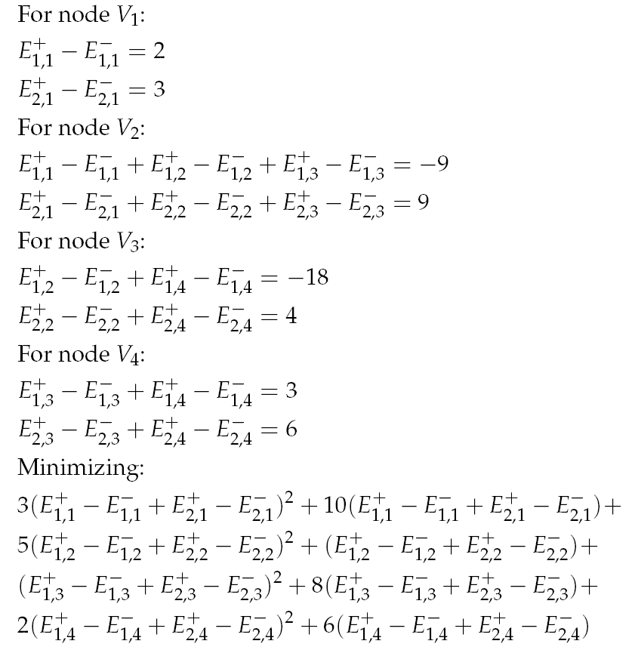
Example
“Plus” Direction
E_{f,e}^{+/-}
+/-
f
e
Direction
File
Edge

Slide 13
Heuristic Approach (Greedy Algorithm)
Make list of all necessary transfers, send files one at time
Each file is sent in a way that minimizes its own download time
The answer is not optimal, but is faster, and using this gives results close to using exact method

Slide 14
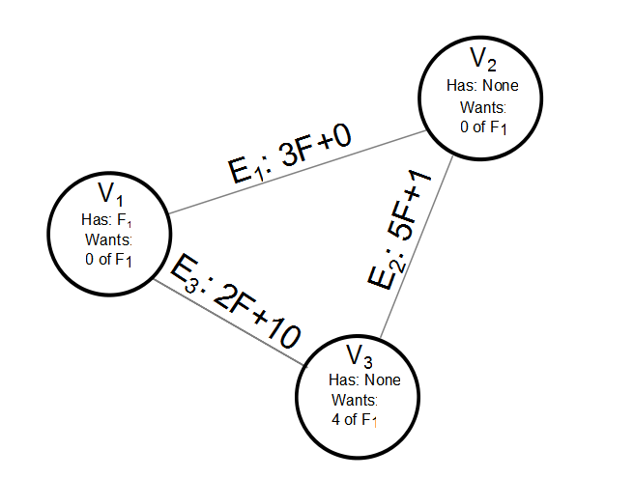
Example
File 1 is here
4 people here are trying to download it.

Slide 15
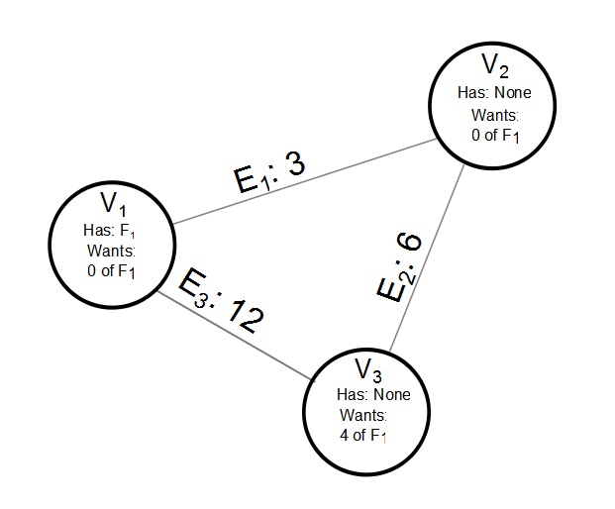
Calculating Optimal Stream Path 1
These are the times it would take just one copy to be sent, obtained by plugging 1 in for F in the bandwidth functions.

Slide 16
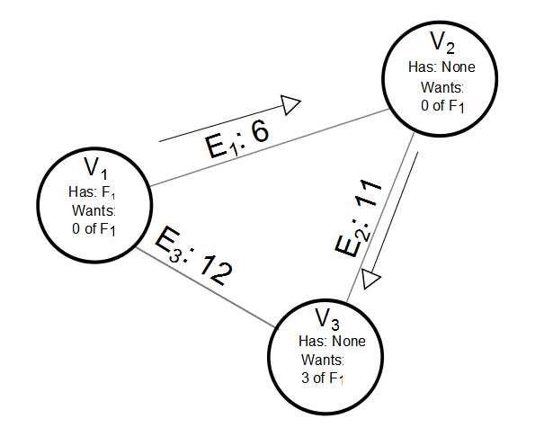
Calculating Optimal Stream Path 2
The first file chooses the shortest path, causing the time along its route to increase.

Slide 17
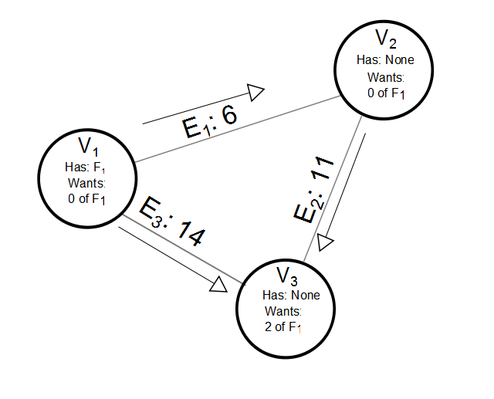
Calculating Optimal Stream Path 3

Slide 18
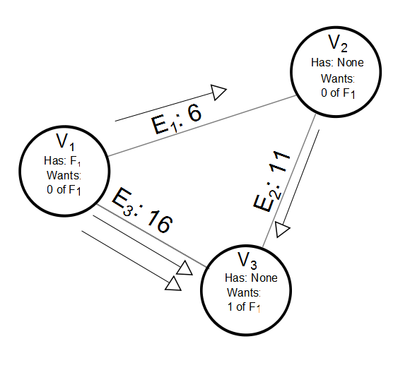
Calculating Optimal Stream Path 4

Slide 19

Resultant Path Diagram

Slide 20
Find Optimal File Arrangement

Slide 21
Genetic Algorithm
Treats each possible solution to the problem as an organism
Each organism is assigned a fitness level, representing how close to optimal that solution is
Population based, pairs of organisms from the current generation are selected to “breed” to make the next generation
Selection is usually done by fitness proportionate selection
Mutation: there is a chance that part(s) of the organism will mutate when a child is born

Slide 22
Application to FAP
In our problem, the organisms are file layouts, represented as N-by-F file matrices
Fitness is the inverse of the optimal average download time given the current demand, calculated with previous methods
Initial population is a randomly generated group of file matrices
Each file layout is chosen so that each nodes has as many copies of files as its capacity allows

Slide 23
Breeding
Two file matrices breed by randomly choosing a cutting point, then recombining the two submatrices as shown:
Result guaranteed to be valid (if no parent is over capacity, children won’t be)
Parents
Children

Slide 24
Mutation
Mutation happens is incorporated by sometimes taking the offspring and randomly changing the files at one of the nodes

Slide 25
Node Scoring Method
Attempts to guess how good a location each node would be for each file, and gives each node a score based on this
Used to assign these scores based on their average distance to users who want each file
Now, random initial file layout is chosen, files are sent to their users optimally, counting how many times each file passes through each node
Score of a node for a file is this number

Slide 26
Node Scoring Method
For each node (randomly chosen), replace low weight file with a high weight file
Calculate new average download time
If it is not an improvement, switch back
Continue until none of the attempted switches decrease the download time

Slide 27
Effectiveness of Methods
Can’t prove answer is optimal
Genetic
Given enough time, always converges
Slower than scoring method
Scoring
Fast, but is random, not always effective
Both methods performed 65% better than random graphs on average

Slide 28
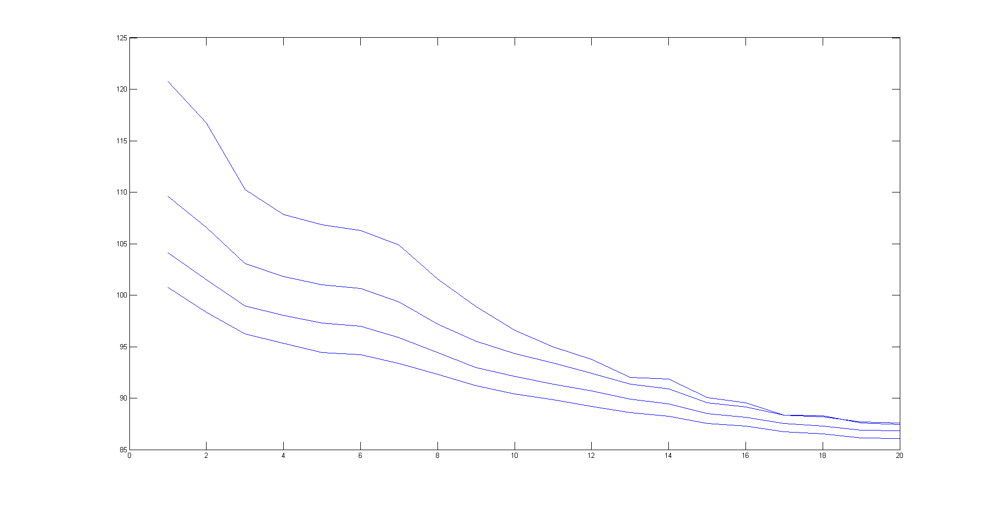
Combination: Intelligent Seeding
0%
Here, instead of solely using randomly generated seeds, we took a portion of them and optimized them with the Node Scoring method, and then genetically optimized the resulting population.
10%
Average Download Time
20%
30%
Generation

Slide 29
Node Failure

Slide 30
Node Failure
Each node has small probability of failing, and does so independently from each other
If all nodes that contain a specific file fail, then that data is lost
Used the Principle of Inclusion-Exclusion (combinatorics technique) to calculate this, given a file arrangement
We tried to minimize the probability of this happening

Slide 31
Fixing Broken Networks
The failure of a node usually lead to the failure of all its connections
The removal of a cut vertex from a graph would disconnect the remaining graph
If a file is demanded by a component of the remaining graph but copy of that file does not exist within the component, it would cause a problem
Disconnected networks could be fixed by building new connections

Slide 32
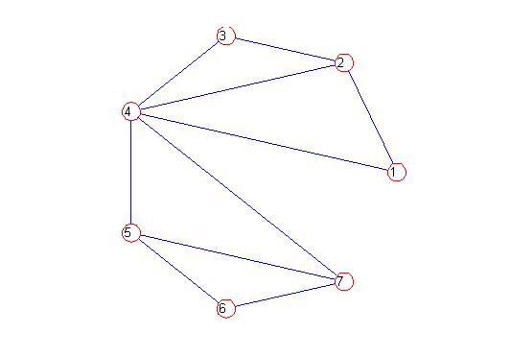
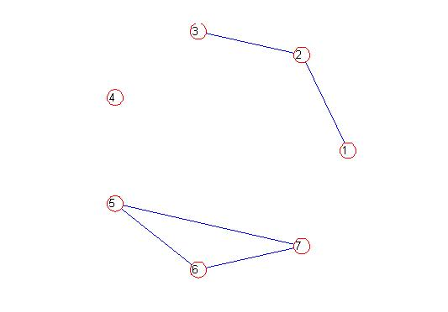
Building Connections
Detect and identify components of the remaining graph
Need at least N -1 new connections to fix a N component graph

Slide 33
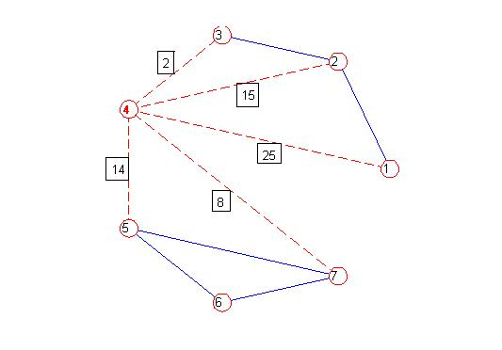
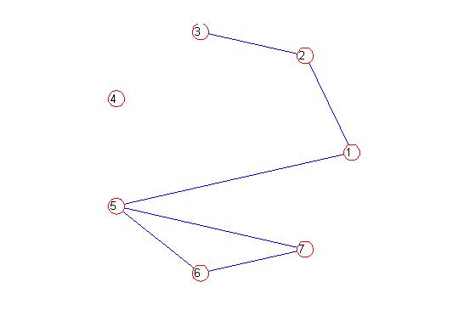
Among the nodes previously connected to the failing node, select those with the highest traffic (on the connection) to build new connections to

Slide 34
GUI Demonstration

Slide 35
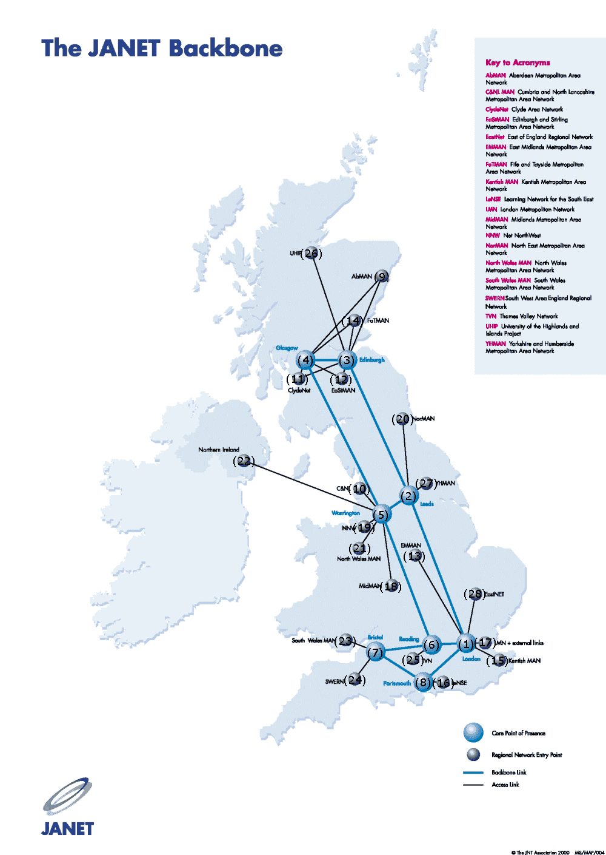
The realistic example

Slide 36
Special Thanks to…
Walter Rusin
Andrea Bertozzi
UCLA Math Department
&
Our Fellow Researchers

